Slide 1
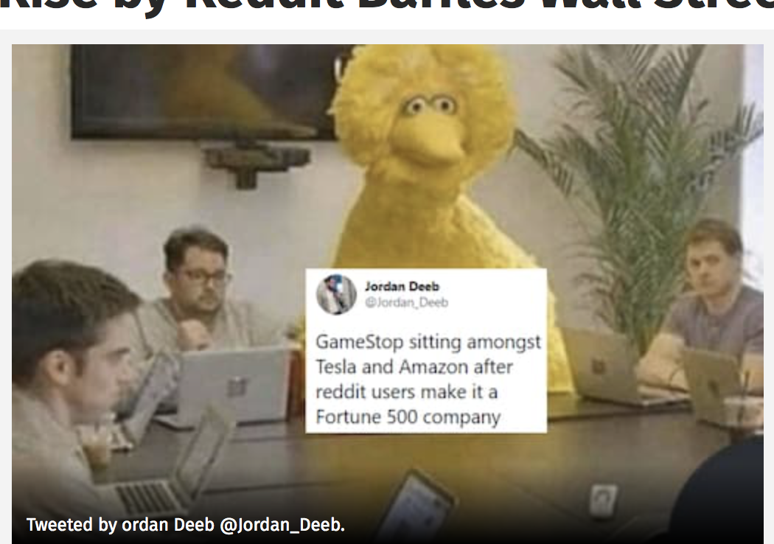
Things to do while waiting:
Type in “investors moderna” into google -> go to site-> click on “corporate presentation”;
Open new tab -> Open yahoo finance -> go to equity screener;
A meme

Slide 2
How to Invest (for beginners):
How to Choose Companies

Slide 3
Agenda
Technical analysis - charts, graphs
Fundamental analysis - numbers
A look at Gamestop, apple, other companies
How to screen for companies
Activity: You will practice researching and analyzing other companies

Slide 4
Analyzing Companies

Slide 5
Technical Analysis

Slide 6
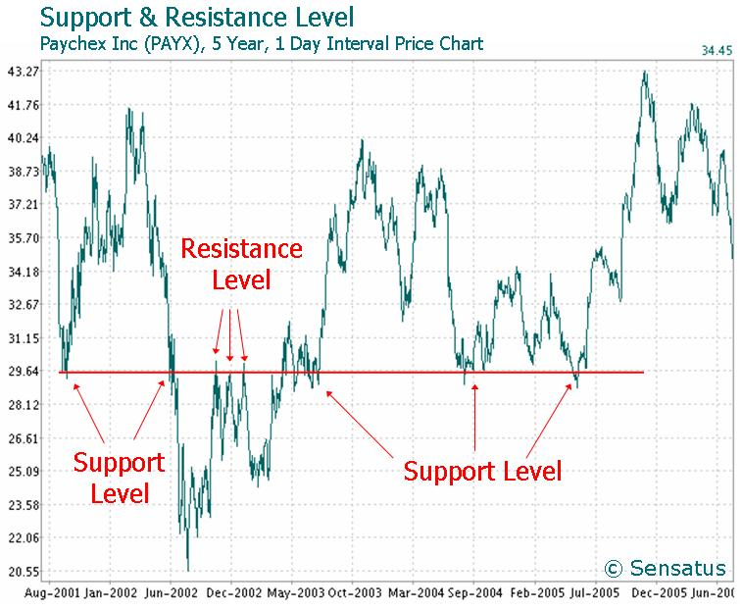
Technical Analysis!
Technical investors rely on the price of a stock
(market performance)
See appendix more specifics
Notes:
Does not take into account other things, like how much the company makes or the value of its products/services (i.e. - fast food).

Slide 7
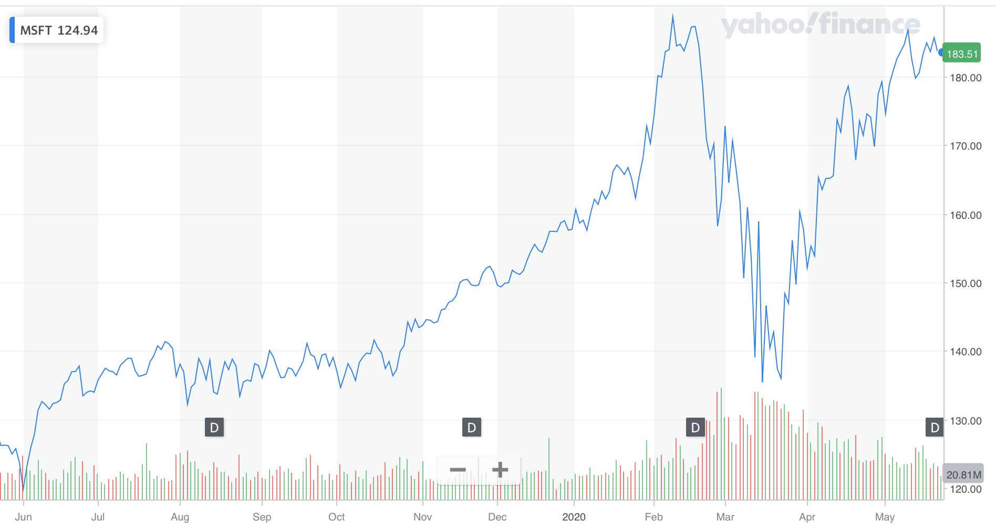
Activity: Guess the price?
Try to guess the direction (up, down, same) of price before moving on...
Notes:
finding profitable companies
learn to look at trend,
patterns (not company) can dictate price
For this activity, I show you a stock chart like the above, cover up half of it, and have you decide whether or not the trend will move up or down based on the trend that you see.
trick: try to look for patterns!

Slide 8
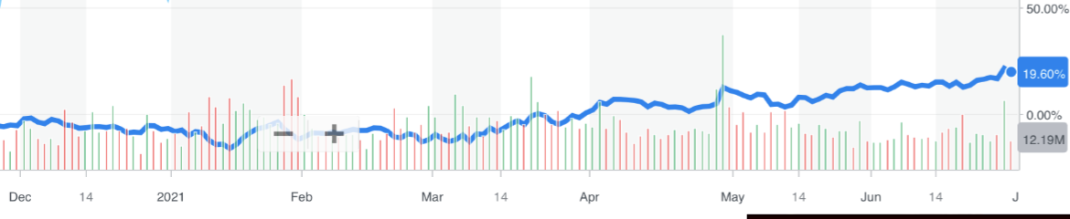
Try to guess the direction (up, down, same) of price before moving on...

Slide 9
Notes:
i’d argue that it mostly stayed the same (if it went up it was by little);
you can probably argue the otherway

Slide 10
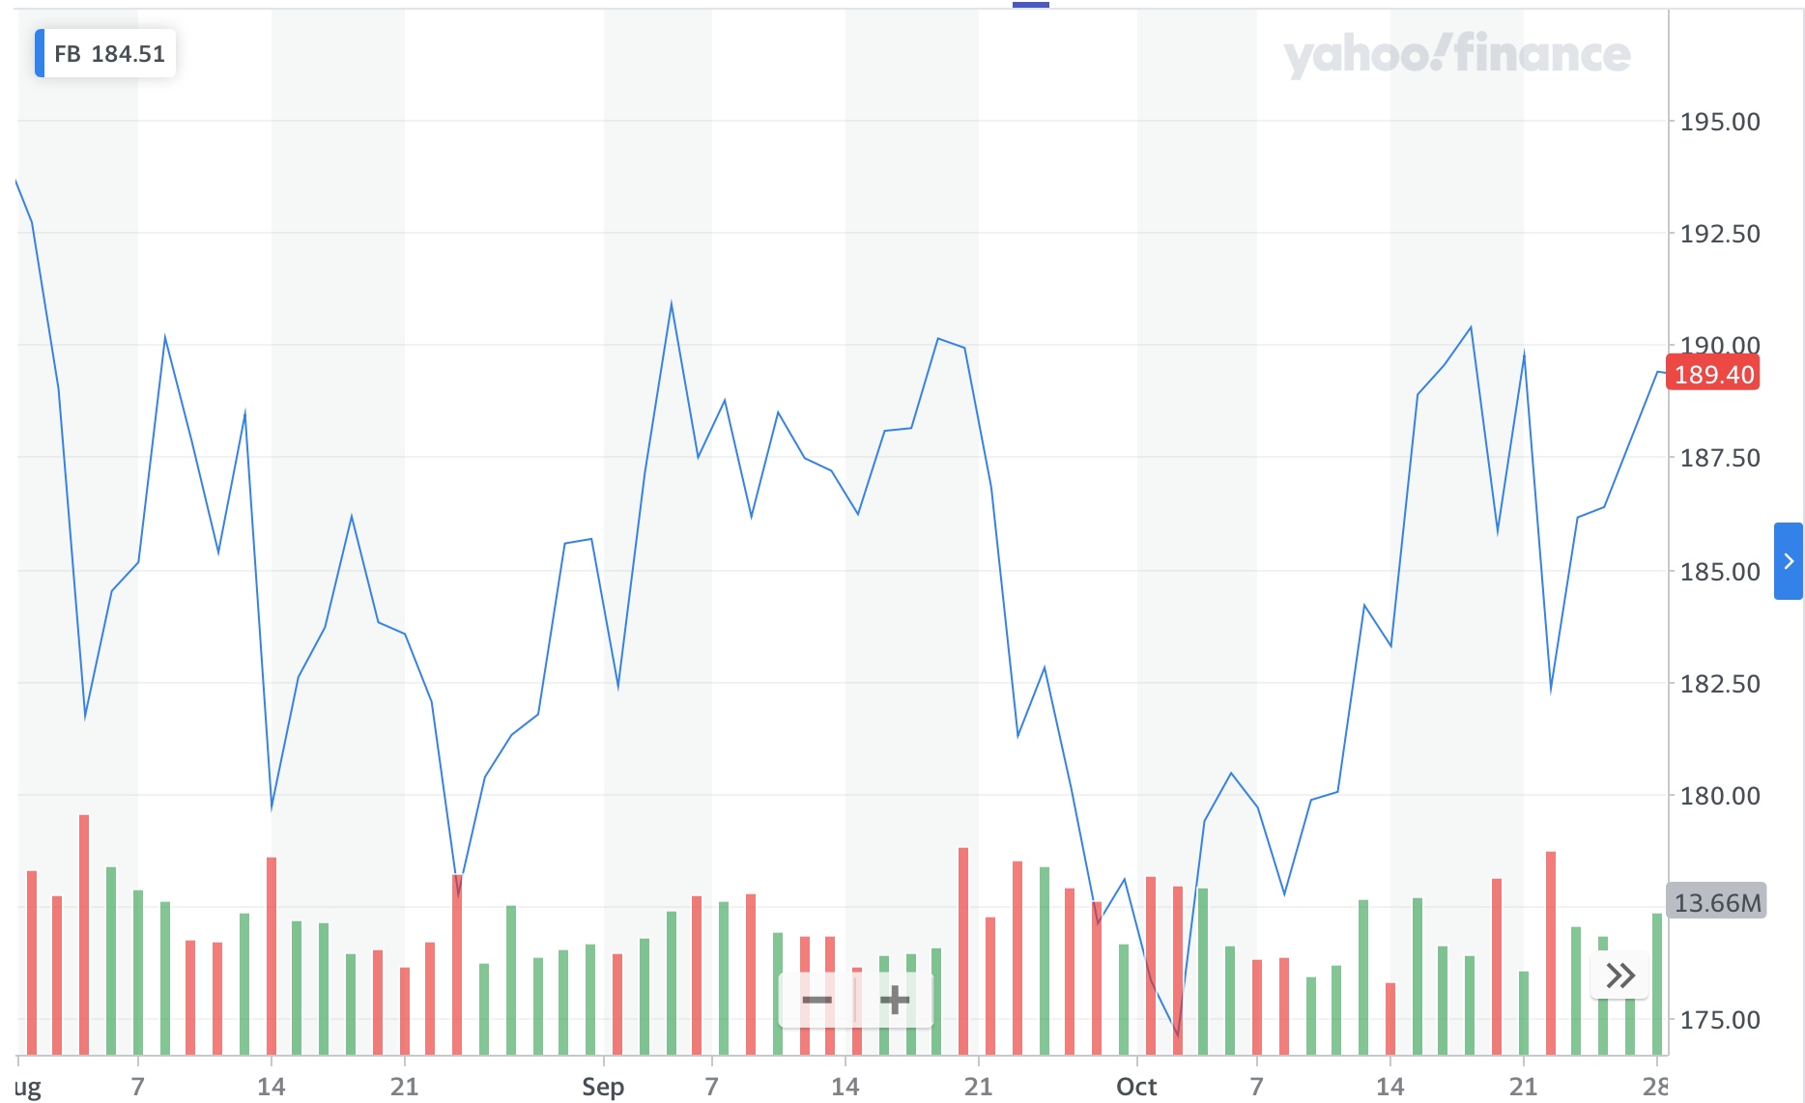
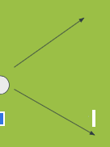
Where is price going?
(b/f 2021)

Slide 11
Notes:
FB is fluctuating (in the long run) so it will continue to fluctuate in the next slide

Slide 12
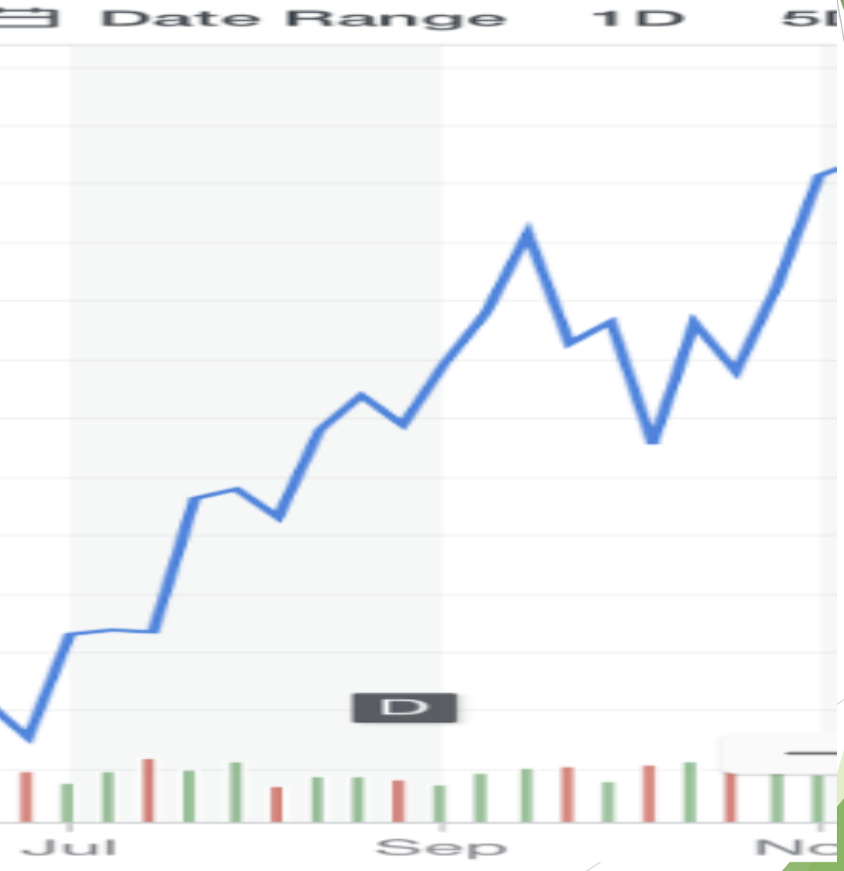
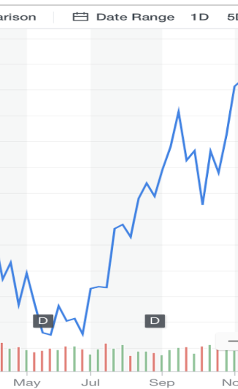

Slide 13
Notes:
The trend is increasing -> so it will continue to increase in the next slide

Slide 14
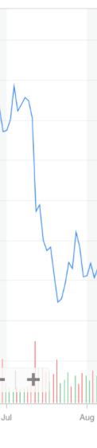
Notes:
The trend is falling here, so it will continue to do that

Slide 15
Notes:
Moral of the story: if the trend of a stock is going up, down, or both, it will likely continue to do that in the next period.
The trend is falling here, so it will continue to do that

Slide 16
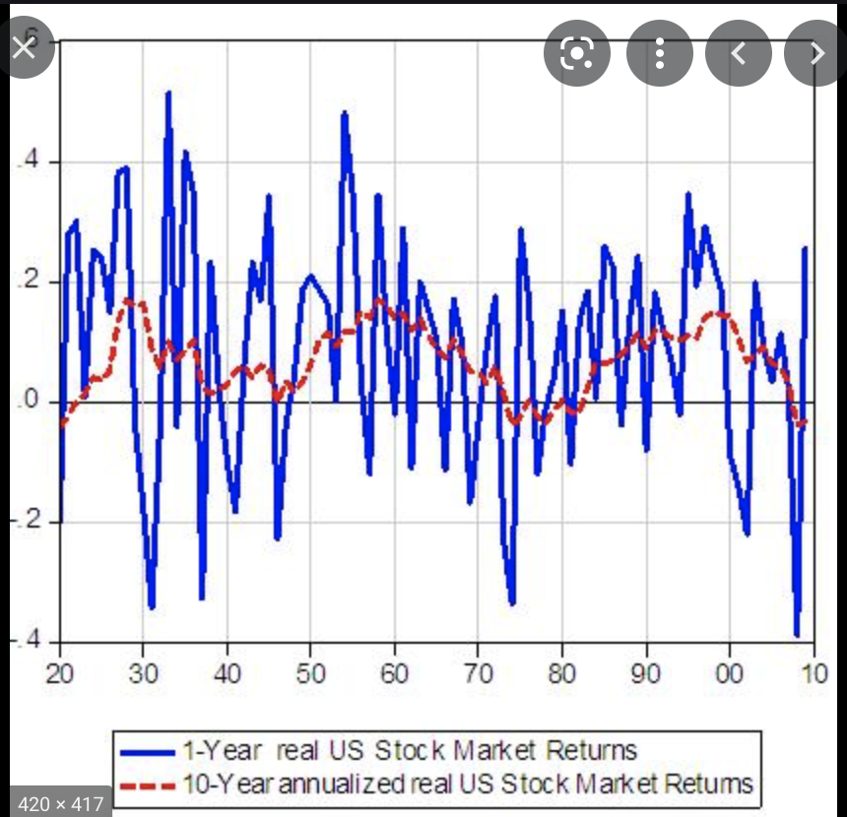
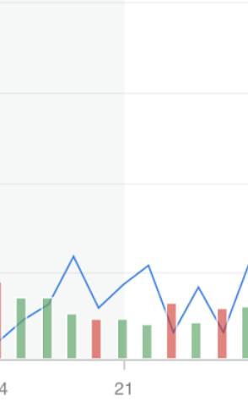
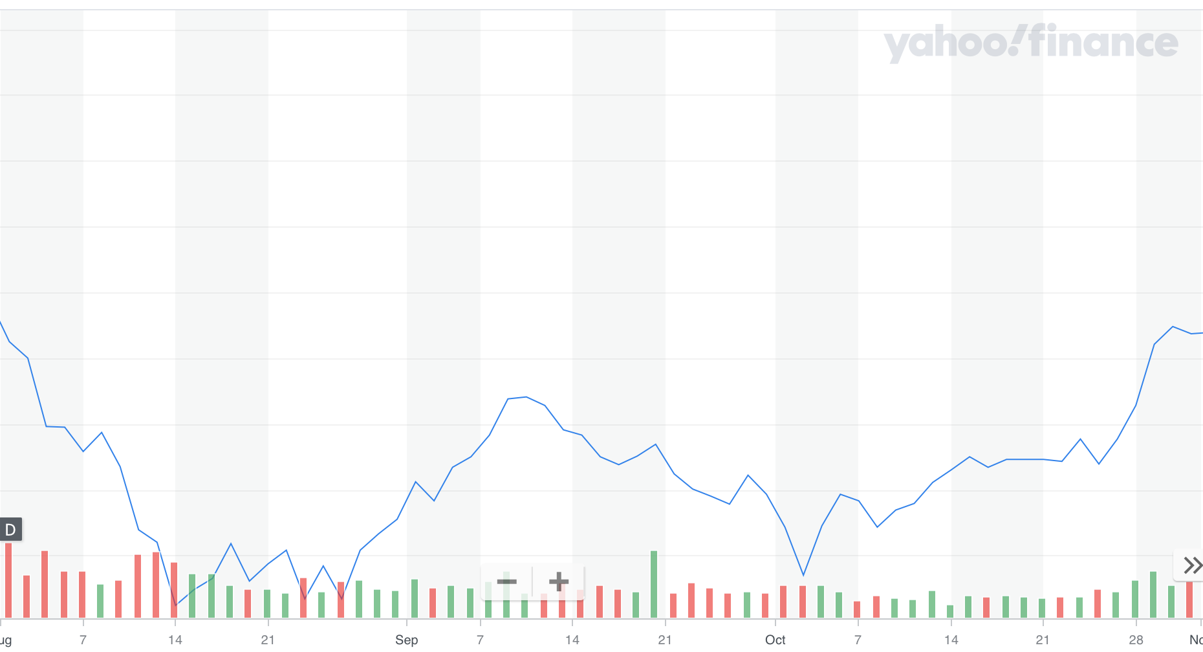
Pfizer - pharmaceutical company
Notes:
~same as FB, is fluctuating

Slide 17
Pfizer - pharmaceutical company
Notes:
~same as FB, is fluctuating

Slide 18
Moral of the story: if the trend of a stock is going up, down, or neither beforehand, it will likely continue to do that in the next period.
Notes:
Moral of the story: if the trend of a stock is going up, down, or both, it will likely continue to do that in the next period.
not always true, in fact , can be the opposite

Slide 19
2) Fundamental Analysis

Slide 20

Invest based on company OVERALL performance……...
  Company profits
  CEOs reputableness
  Is the product a medical benefit?

Slide 21
Two types - qualitative and quantitative!

Slide 22
Qualitative

Slide 23
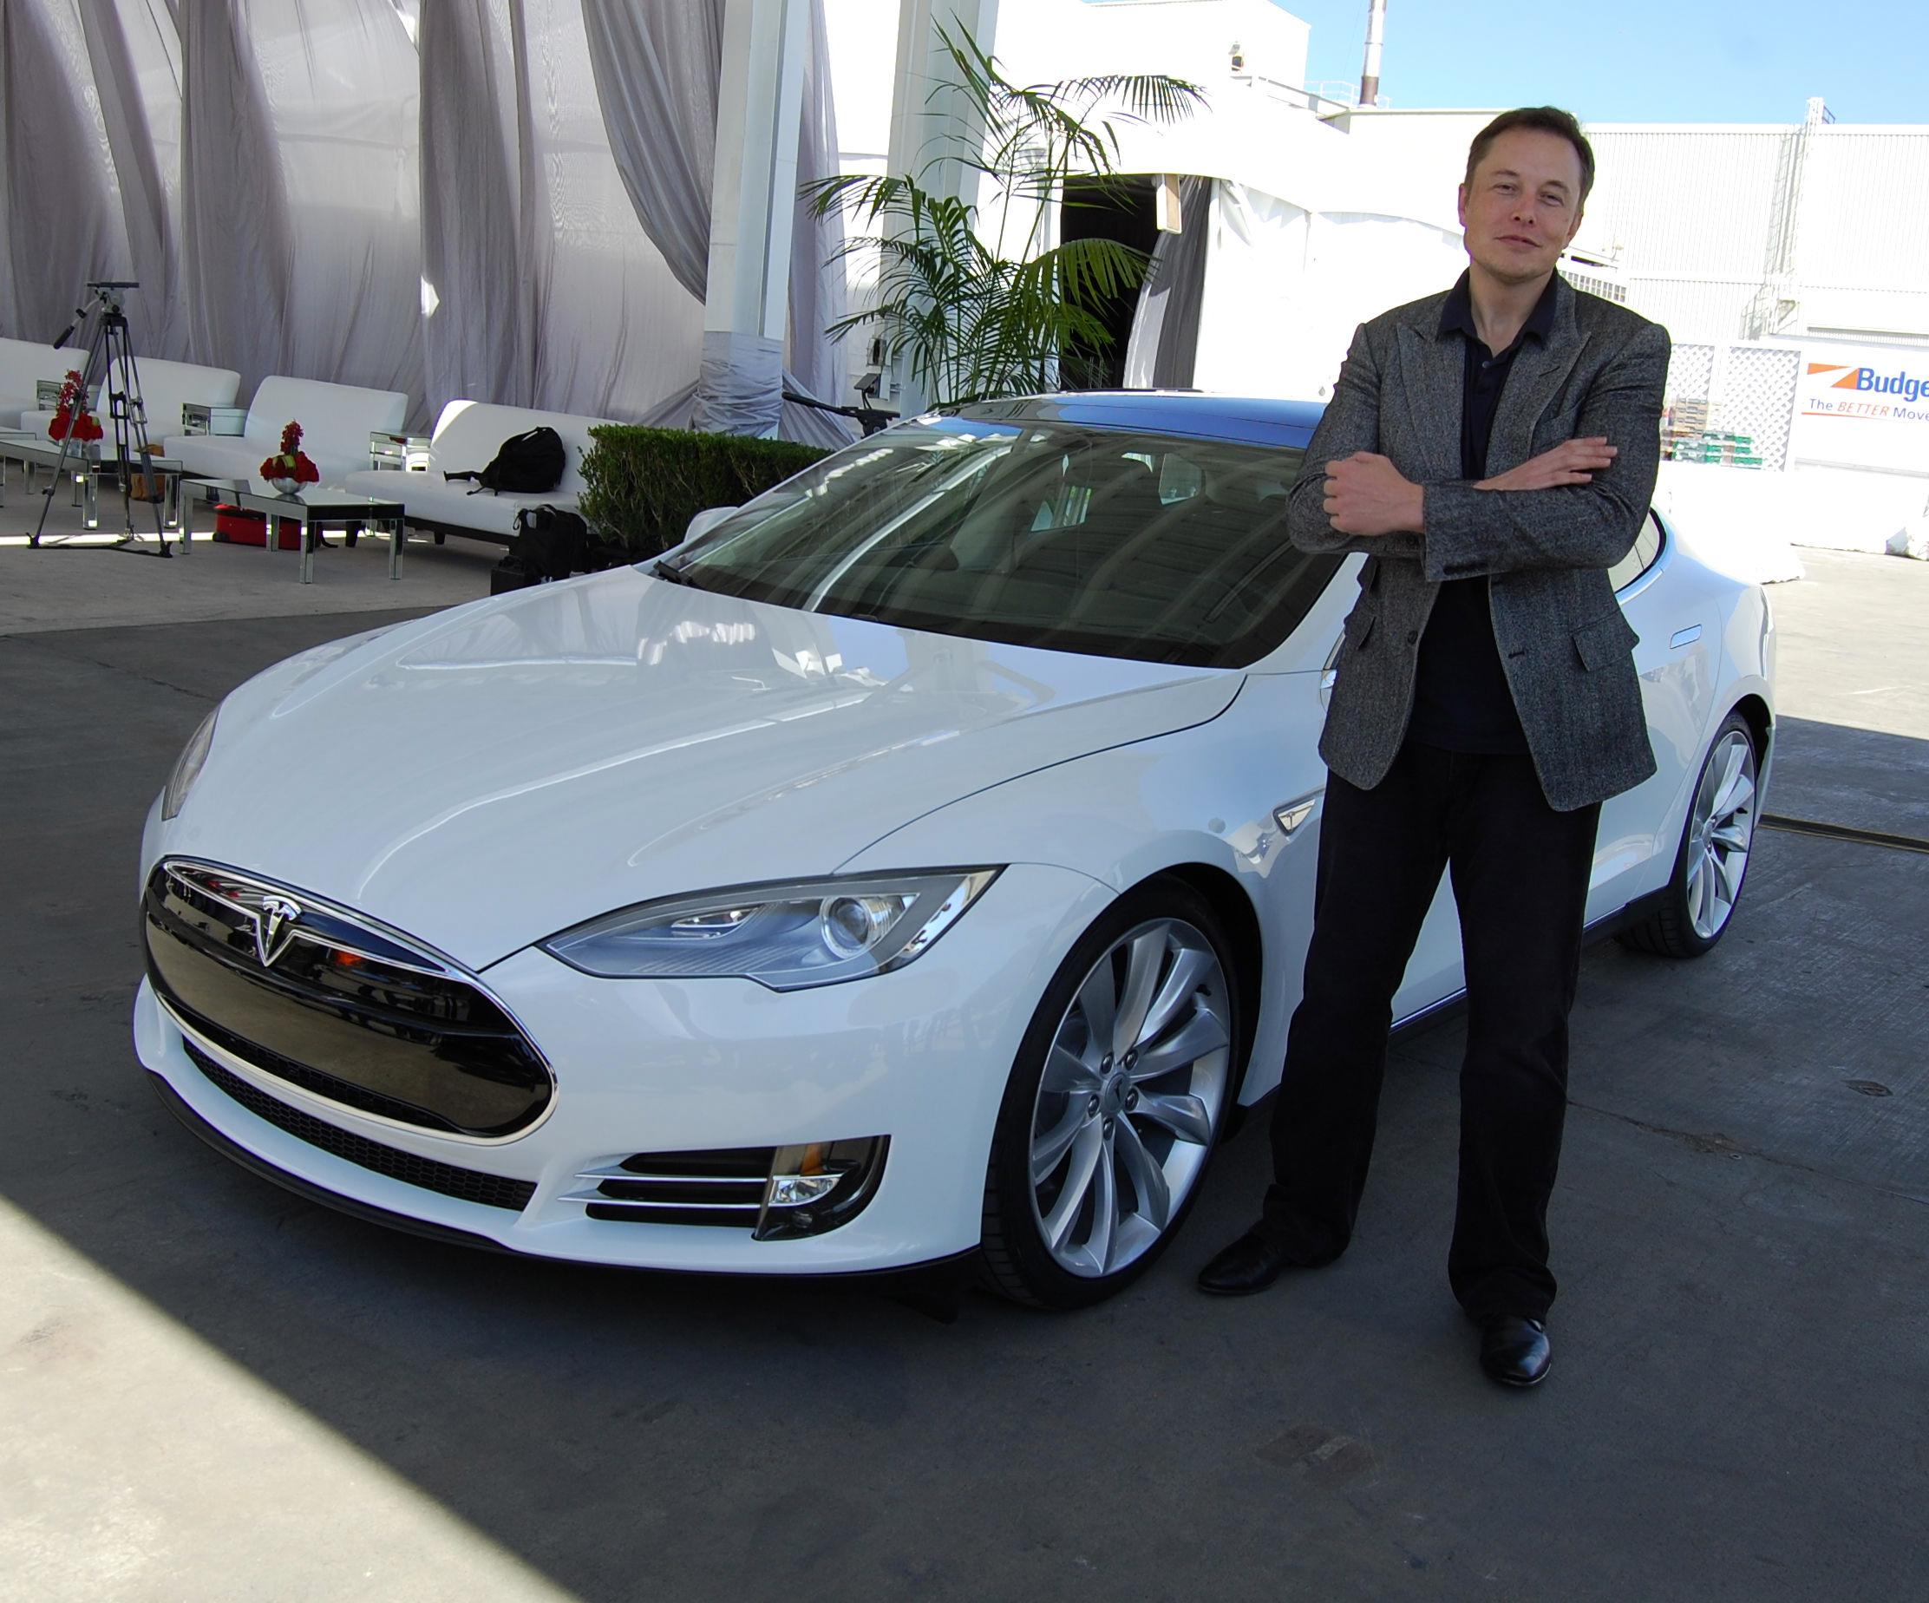
Qualitative
Business Model
  what does the company do?
  Who is affected?
Notes:
Which of the following is true about cash?
is an asset
can save companies from bankruptcy
is a liability
11) what is the benefit of cash flow?
tells you how financially stable a company is
tells you how profitable a company is
tells you how valuable a company is
Difference betwe
are the products important, especially now
what do you know about the ceo? iis he responsible? notable
what about competitors, how many times have you’ve gove there over bbby?

Slide 24
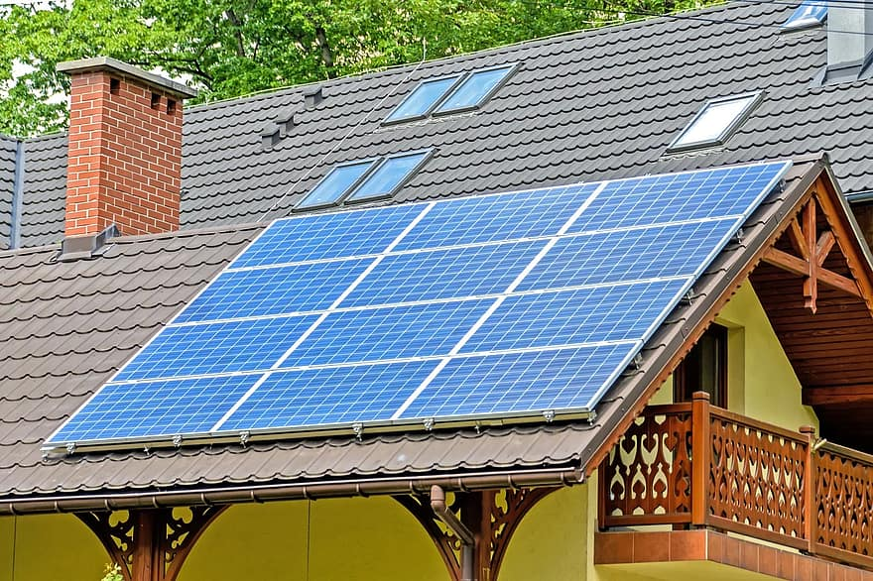
CARS and SOLAR ENERGY

Slide 25
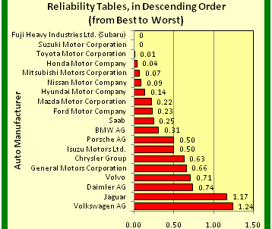
Qualitative
Competition
  Who is the company, generally, facing?
Notes:
Which of the following is true about cash?
is an asset
can save companies from bankruptcy
is a liability
11) what is the benefit of cash flow?
tells you how financially stable a company is
tells you how profitable a company is
tells you how valuable a company is
Difference betwe
are the products important, especially now
what do you know about the ceo? iis he responsible? notable
what about competitors, how many times have you’ve gove there over bbby?

Slide 26
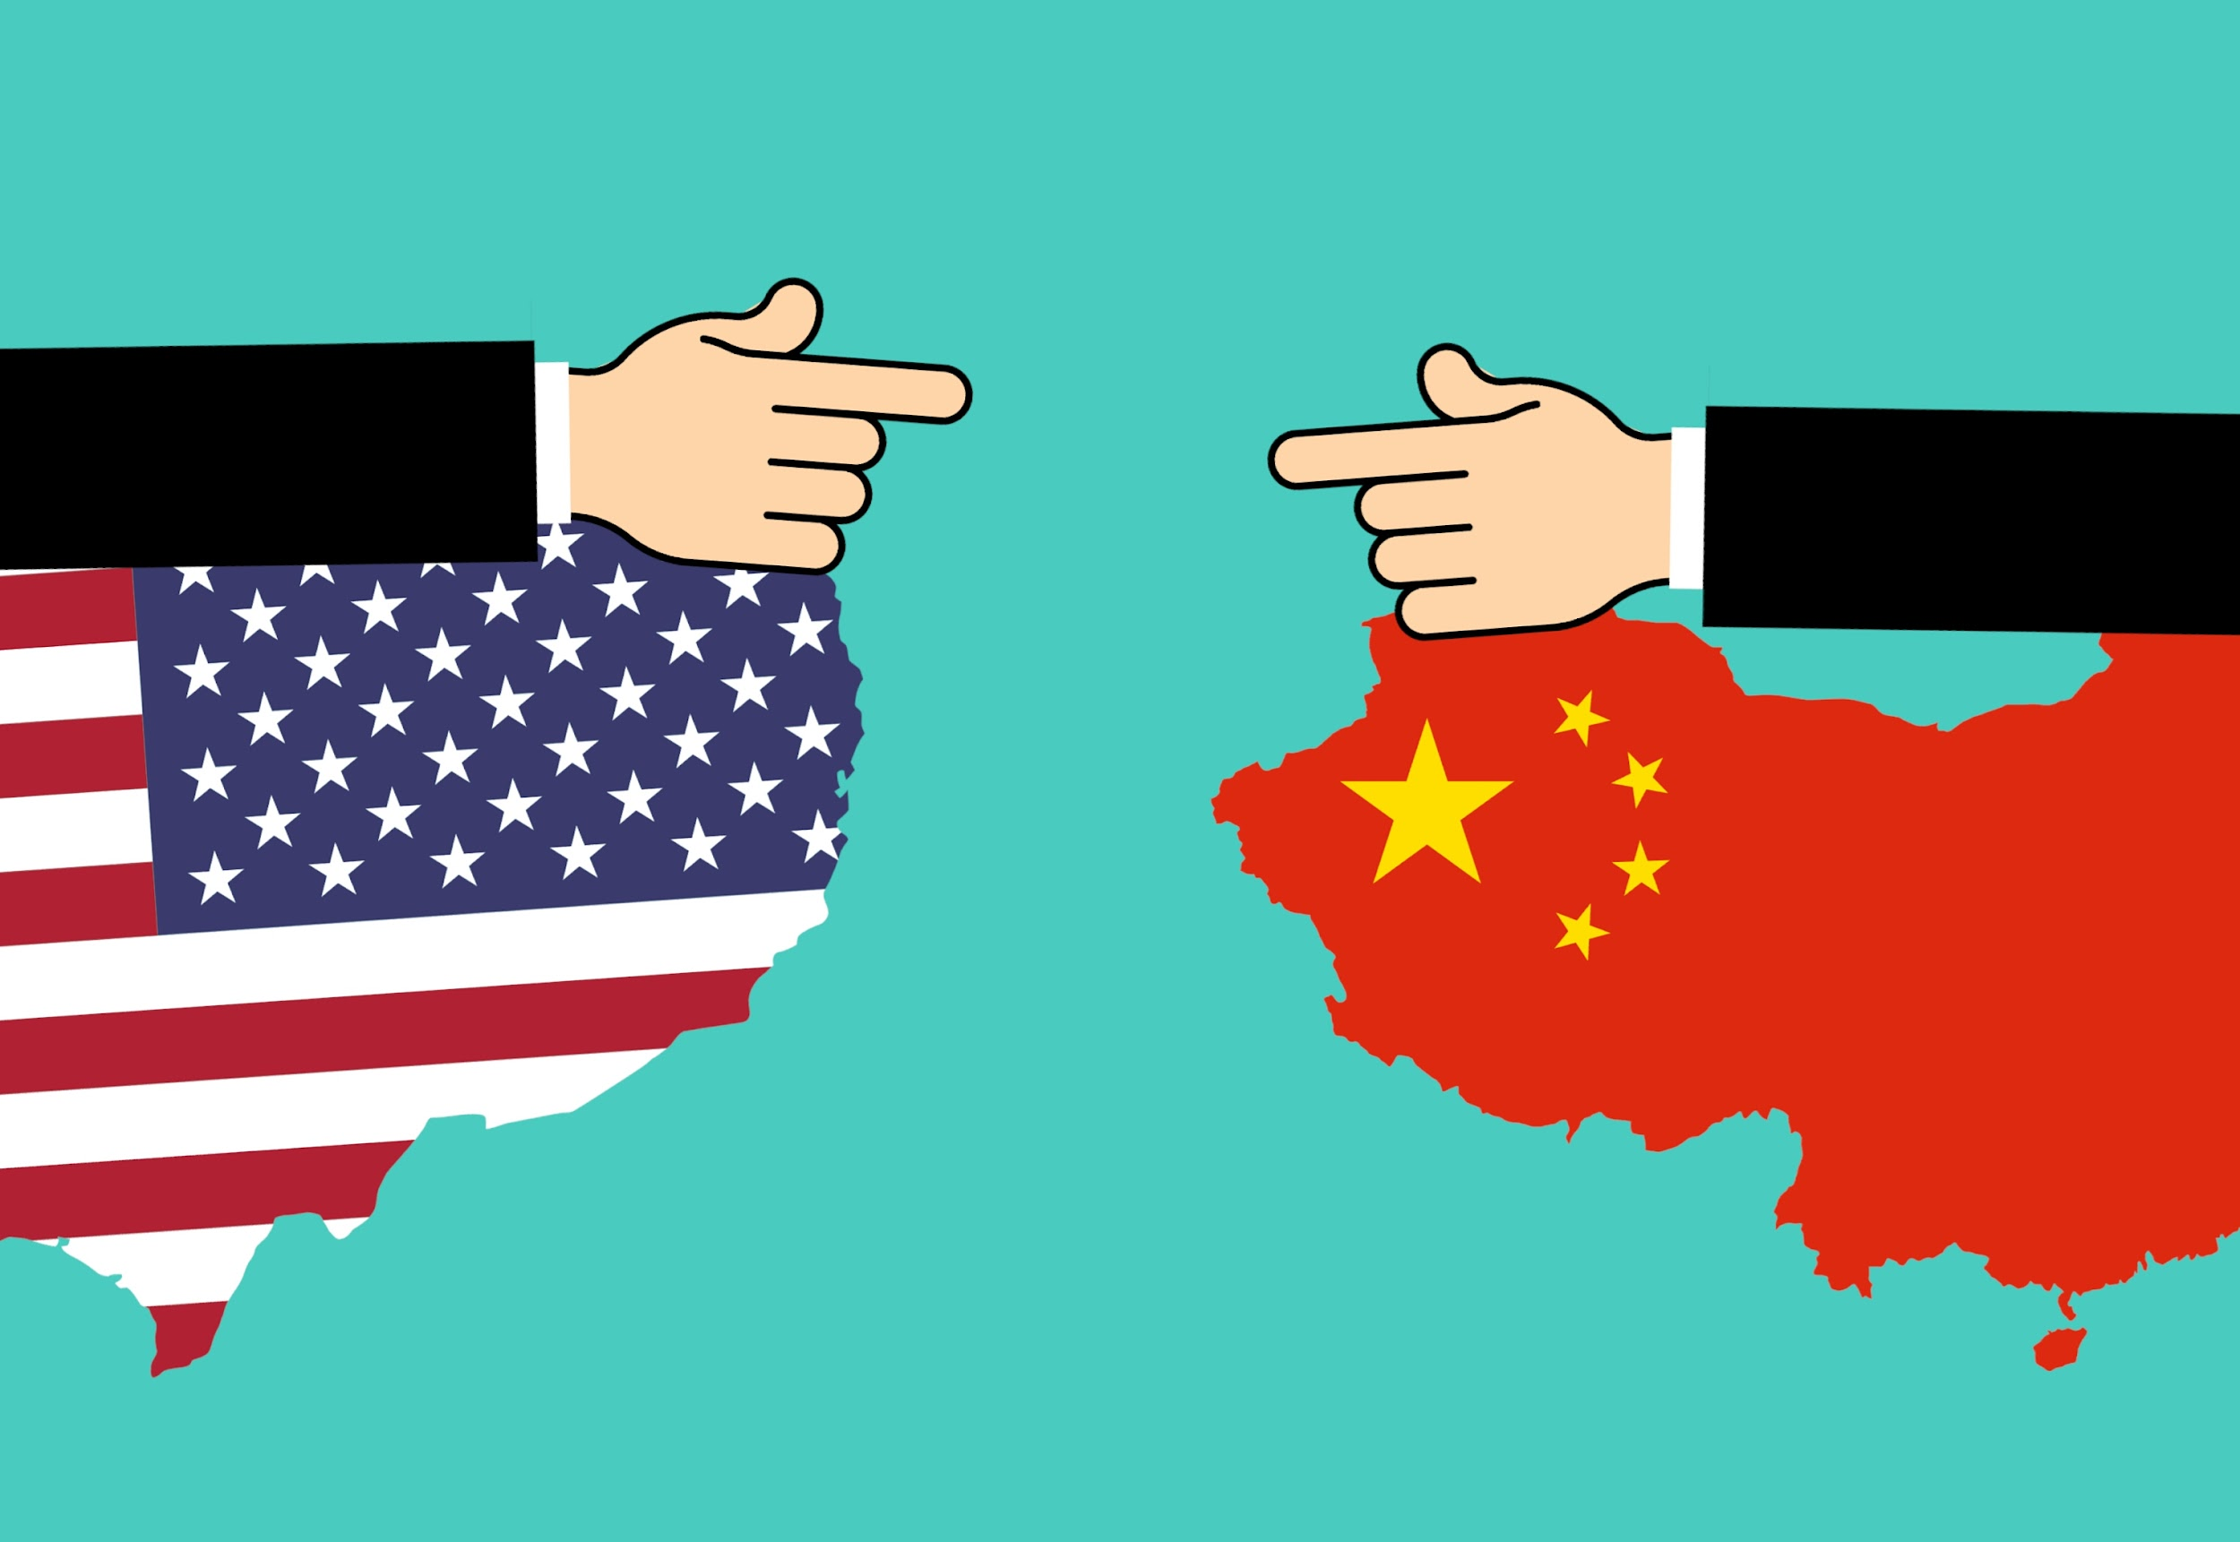
Trade War
Affects competition
Can negatively affect U.S. companies, for instance

Slide 27
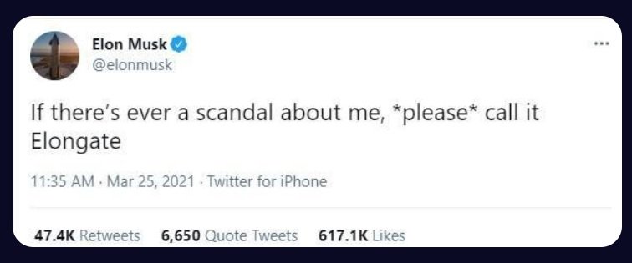
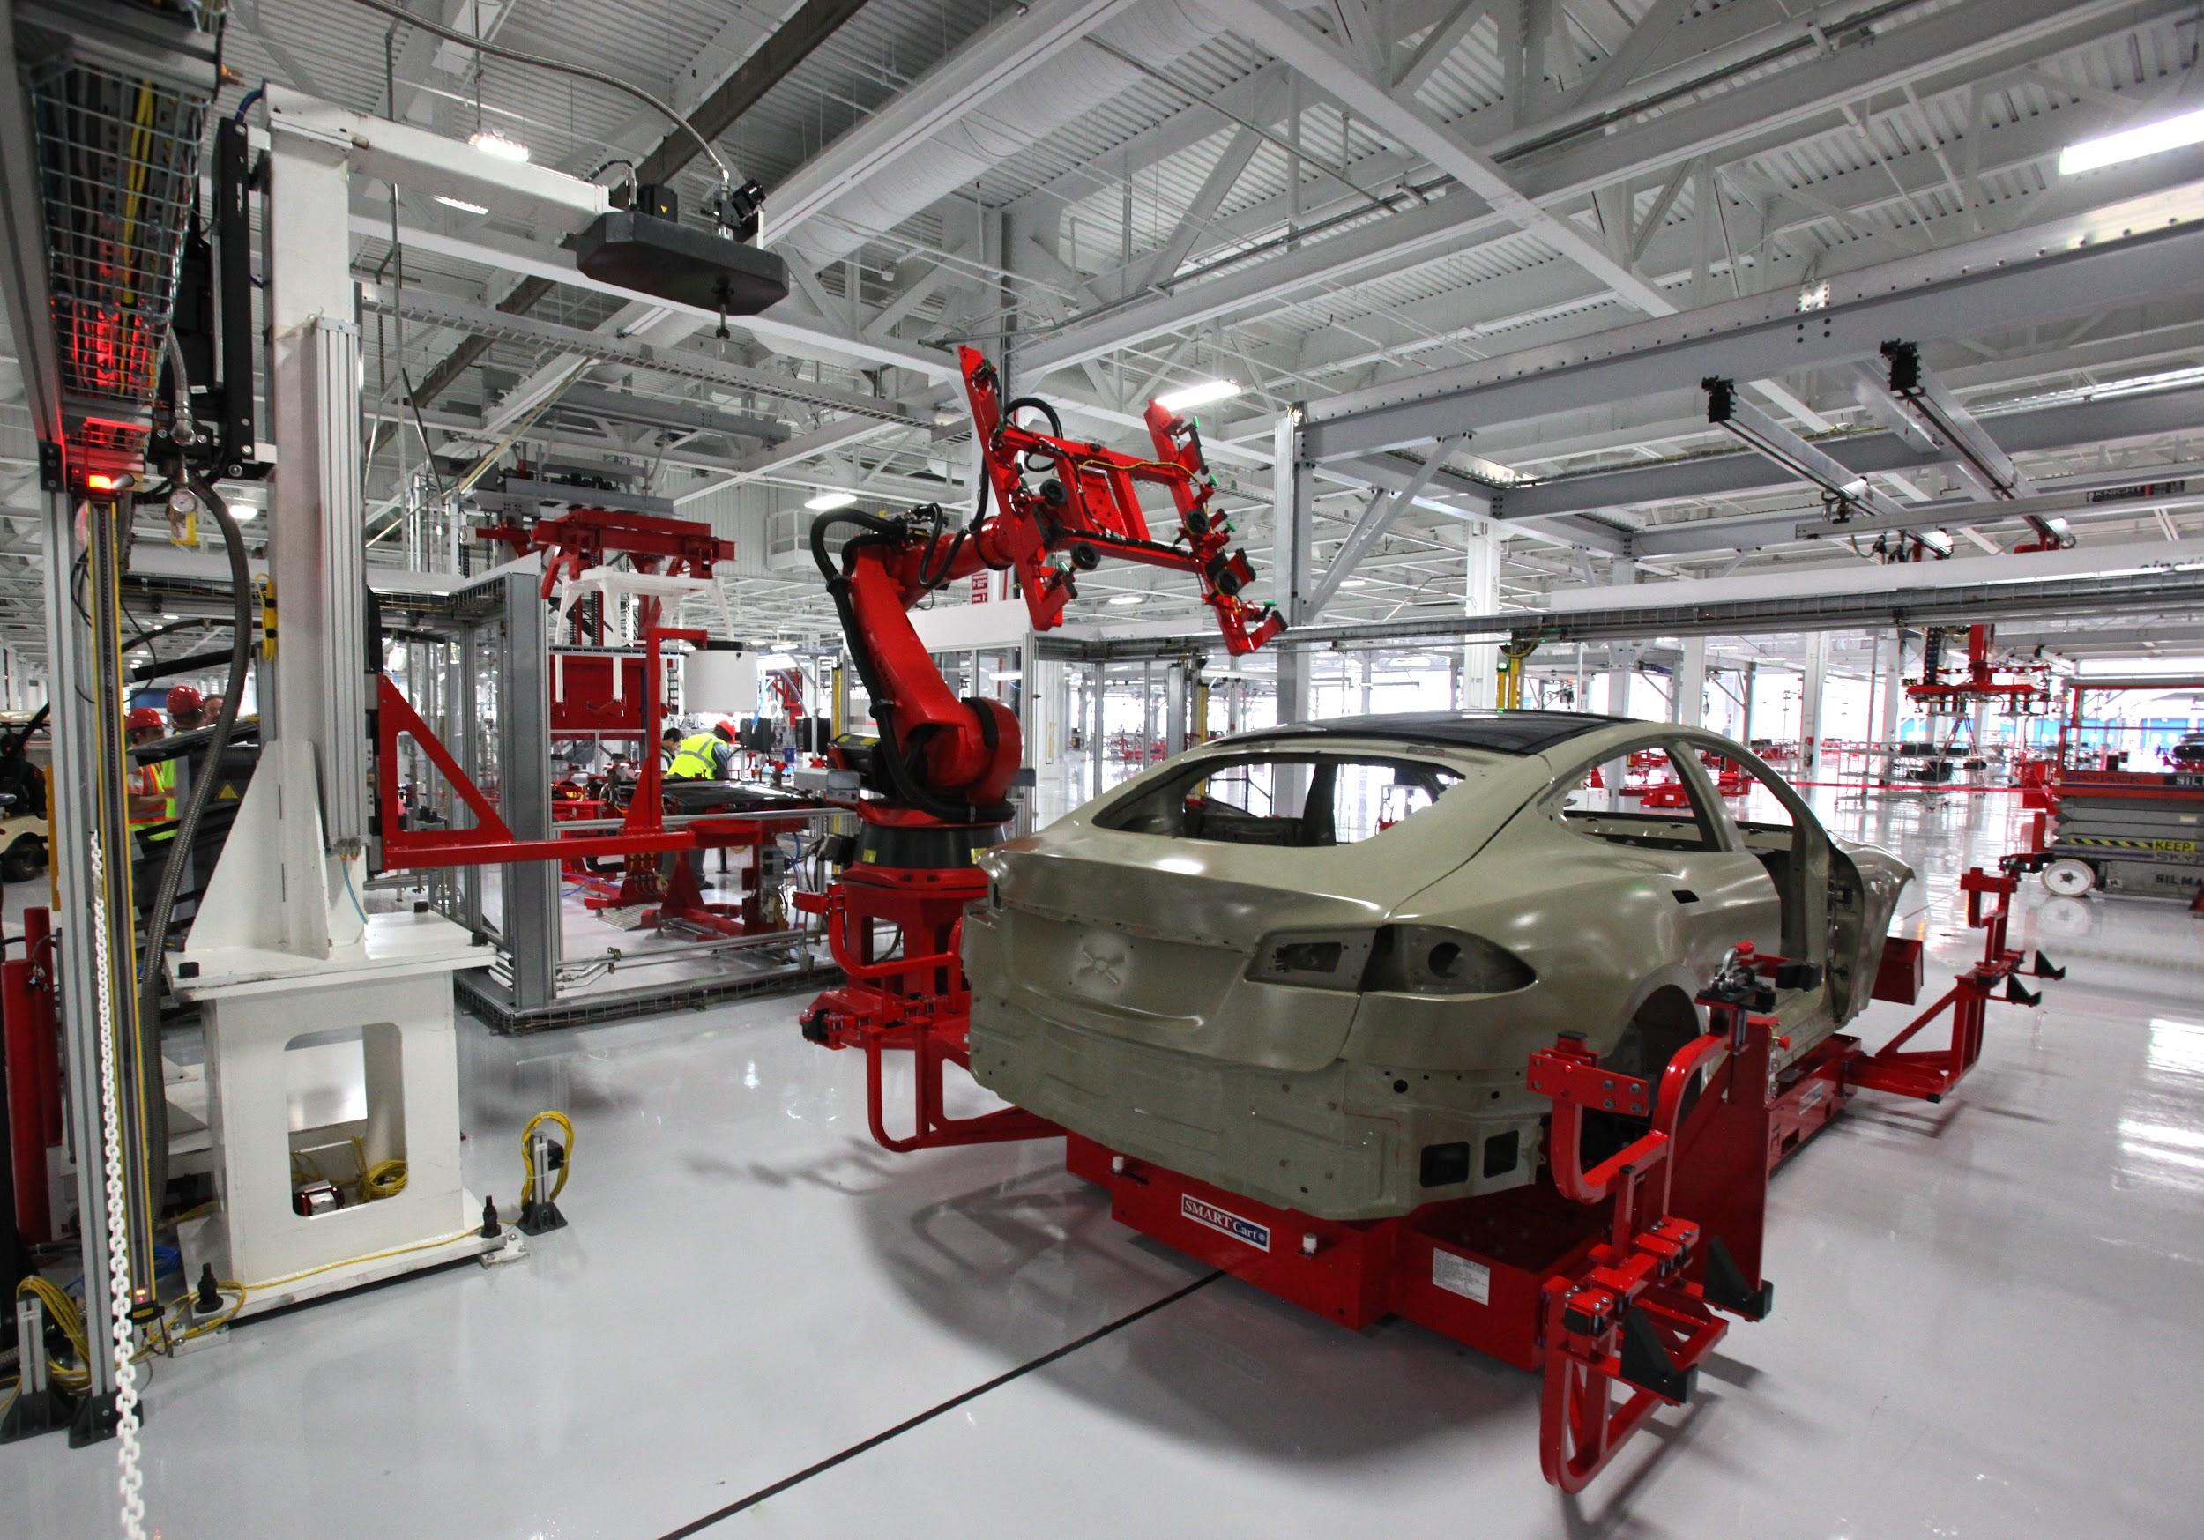

Qualitative
Who is the CEO?
What is the strategy?
Most valuable product
Notes:
Which of the following is true about cash?
is an asset
can save companies from bankruptcy
is a liability
11) what is the benefit of cash flow?
tells you how financially stable a company is
tells you how profitable a company is
tells you how valuable a company is
Difference betwe
are the products important, especially now
what do you know about the ceo? iis he responsible? notable
what about competitors, how many times have you’ve gove there over bbby?

Slide 28
Which of the following does NOT encompass a qualitative analysis?
Business model
The CEO’s statements
Company profits
Company competition

Slide 29
Quantitative
(numbers)

Slide 30
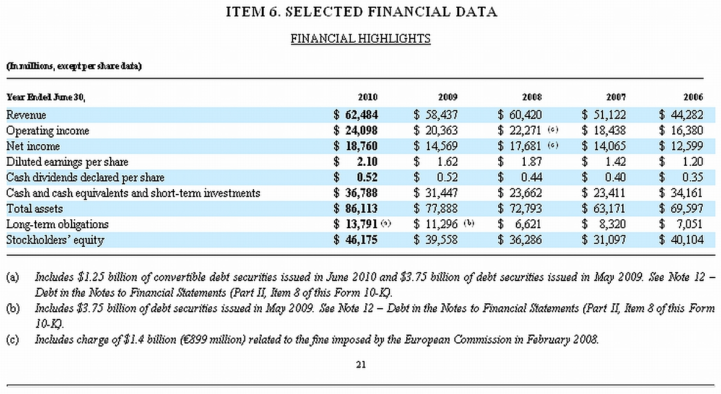
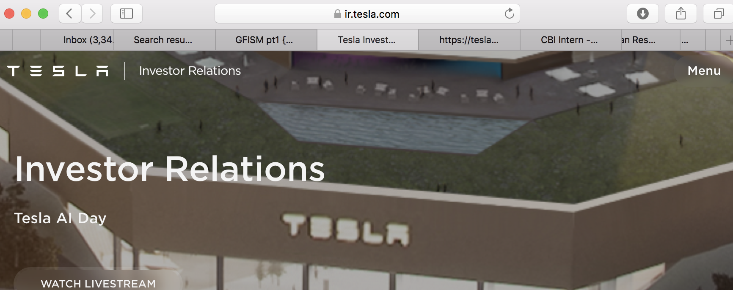
Investors Earnings
Report
10k
  report of company’s performance
go to “investors *company name here* com”
Notes:
Which of the following is true about cash?
is an asset
can save companies from bankruptcy
is a liability
11) what is the benefit of cash flow?
tells you how financially stable a company is
tells you how profitable a company is
tells you how valuable a company is
Difference betwe
are the products important, especially now
what do you know about the ceo? iis he responsible? notable
what about competitors, how many times have you’ve gove there over bbby?

Slide 31
Three IMPORTANT financial sheets
Balance, cash, income

Slide 32
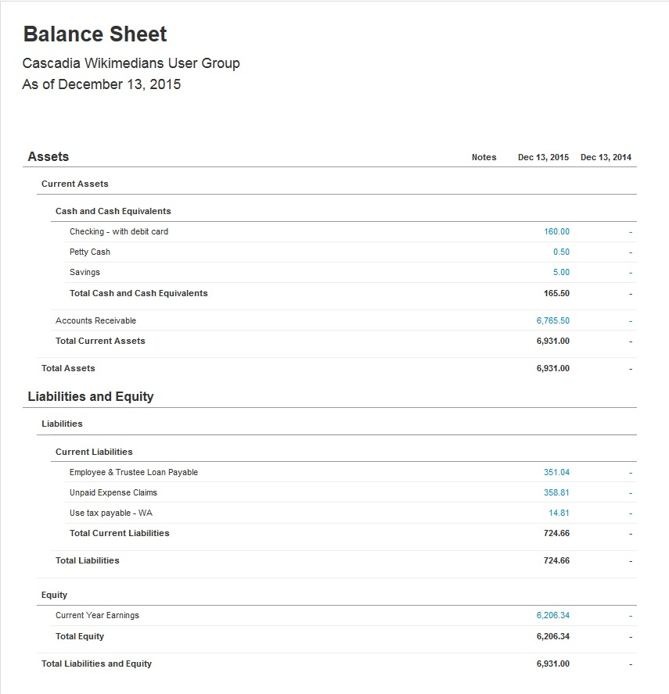
Quantitative (numbers)
How much money is the company worth? (Balance sheet)
how much money is the company making? (Income Sheet)
How much money is in cash? (Cash Flow)
Notes:
REORDER POINT

Slide 33
BALANCE SHEET STATEMENT

Slide 34
How MUCH money is the company worth?

Slide 35
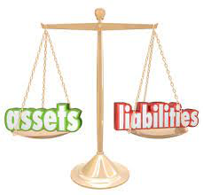
Balance Sheet
Notes:
Balance Statement - can be used to determine the monetary value of a company in time.
balance because you have assets on one end and liabilities on the other.
liabilities - where you get your money from? (money influx?) loans
assets - how you spend that money (money outpour) - computers? office space?
WE FOCUS HERE ON ASSETS

Slide 36
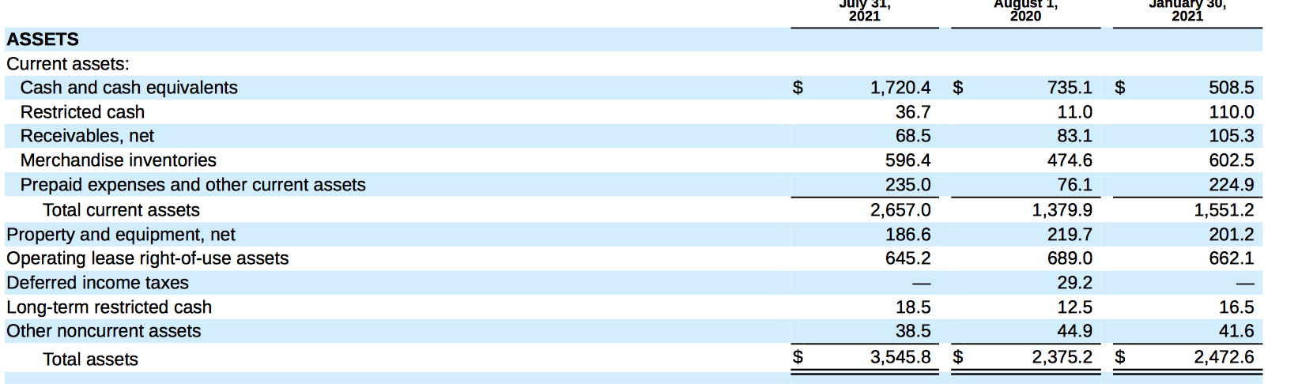
Assets - anything w/ value of anything (products, cash, property)
  PPE (plants, property, equipment)
  Cash
  Receivables (loans from other companies)
can be used to determine the
monetary value of a company
in time.
gamestop
Notes:
Current - assets that are here and can be used / sold NOW; non-current - assets yet to come (investments,)
pay attention to TREND of assets over time (where is it?)
When companies like APPLE buy companies, this is the sheet used to ascertain value
Three types
now to balance statement - which can be used to determine monetary value of company
assets -> is monetary of company (desk, chairs, products, etc. - usually tangible things)
bbby was stagnate - not notable
assets - give you idea of how much a company owns (value)
can be used to determine how much a company costs when buying.
If assets are high - more (material) value
might want to invest?
value here is stag
missing liabilities
Cash ->
Receivables - money that is owed
Inventory -
Launch Quick quiz:
What is a fundamental analysis?
looking at price trends
looking at things like company revenue
neither
both (a/c)
How do you find net income?
sales from product minus ALL costs
Profit from other places minus All costs
What is it used for?
reinvestment into product
dividends
all of the abobe
What are assets?
cash value of company possession
money owed to another company
What are liabilities?
cash value of company possession
money owed to another company

Slide 37
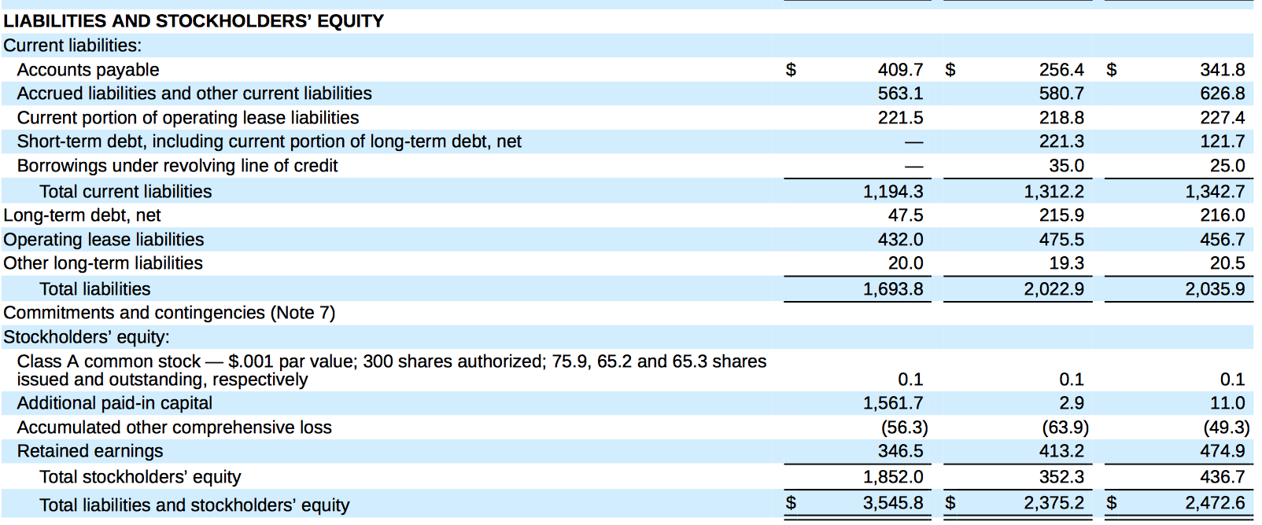
Liabilities - where companies get their money)
  debt and equity
    debt - loans from investors/others
    equity - money from stockholders
again can be used to determine the
monetary value of a company
in time.
gamestop
Notes:
Current - assets that are here and can be used / sold NOW; non-current - assets yet to come (investments,)
pay attention to TREND of assets over time (where is it?)
When companies like APPLE buy companies, this is the sheet used to ascertain value
Three types
now to balance statement - which can be used to determine monetary value of company
assets -> is monetary of company (desk, chairs, products, etc. - usually tangible things)
bbby was stagnate - not notable
assets - give you idea of how much a company owns (value)
can be used to determine how much a company costs when buying.
If assets are high - more (material) value
might want to invest?
value here is stag
missing liabilities
Cash ->
Receivables - money that is owed
Inventory -
Launch Quick quiz:
What is a fundamental analysis?
looking at price trends
looking at things like company revenue
neither
both (a/c)
How do you find net income?
sales from product minus ALL costs
Profit from other places minus All costs
What is it used for?
reinvestment into product
dividends
all of the abobe
What are assets?
cash value of company possession
money owed to another company
What are liabilities?
cash value of company possession
money owed to another company

Slide 38
Quiz
What are assets? liabilities?
  cash value of company’s possessions
  money owed to another person
Notes:
a - assets
b - liabilities

Slide 39
INCOME STATEMENT

Slide 40
How MUCH money is in CASH?

Slide 41
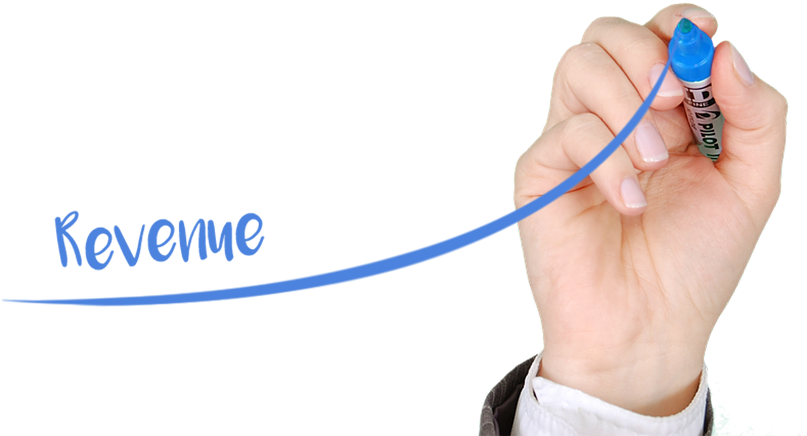
Income Statement
Notes:
cash flow - how much cash is generated or spent (net)
3 sources of cash flow (we’ll see them)/outflows

Slide 42
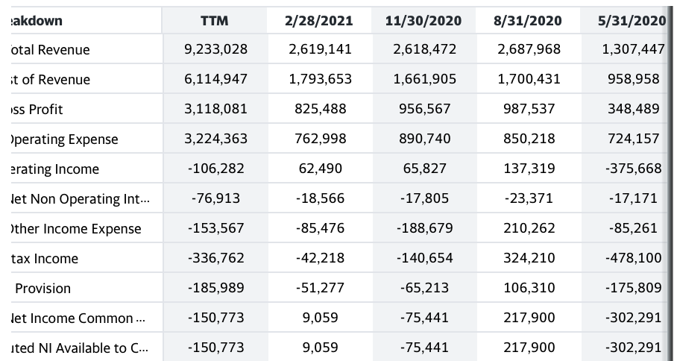
BED, BATH, BEYOND
Income Statement - Tells you how much profit/rev a company makes
Total Revenue - money made from sales of good (towels)
*Net Income = Revenue-cost; its profit; is an indicator or future growth
Notes:
Was BBY a good company?
Income Statement - Tells you how much profit/rev a company makes
revenue is found on top: quarterly rev is given - look at the trend
if you want net income (revenue minus cost) look down
takeaway looking at both give you a clue for how profitable a company is
food for thought - when is revenue more important than net income and vice cersa
Total Revenue - money made from sales of good (towels)
stagnates here
Cost - cost associated with towel productions
Time permitting:
Revenue - Cost of ALL expenses (ads) = NI
extra cash for reinvestment
fluctuate, close to negative

Slide 43
CASH FLOW STATEMENT

Slide 44
How MUCH money does the company make?

Slide 45
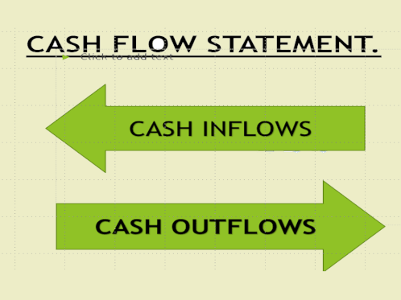
Notes:
cash flow - how much cash is generated or spent (net)
3 sources of cash flow (we’ll see them)/outflows

Slide 46
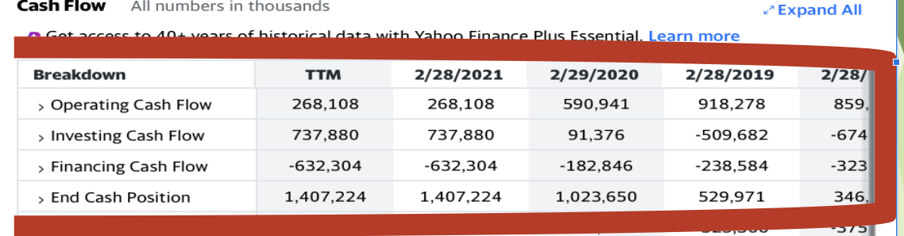
Cash Flow- BBY
Cash Flow - give an idea of how stable a company is (if likely to bankrupt or no)
found using end cash position;
sources are operating, investing, financing
Three sources of cash
Notes:
Cash Flow - give an idea of how stable a company is (if likely to bankrupt or no)
End Cash Position => Operating + Investing + Financin
if there’s time, i’ll define them (
FRE cash flow = cash coming in - accounting for debt/capital/other hidden costs
operating - money from operations (selling products)
inventory - money from selling land/otther assets
financing - money from stocks/bond******chech
)
>>>>>for bbby cash flow of company increasing , a good thing
difference in income ane cash
if a company has profit, but its not in cash, its in danger;
it cant pay up right away
reflective of the fact taht in the past in was too fail
- - - - - - - - - - -
Before 2020, BBBY had very little growth, would not invest
but because of increases i showed you, perhaps can lead to profit (IF that’s your goal)

Slide 47
Cash Flow- BBY
operating - company operations
investing - company investments (assets, land)
financing - loans (bond), stocks, etc.
Will it go bankrupt soon?
Notes:
Cash Flow - give an idea of how stable a company is (if likely to bankrupt or no)
End Cash Position => Operating + Investing + Financin
if there’s time, i’ll define them (
FRE cash flow = cash coming in - accounting for debt/capital/other hidden costs
operating - money from operations (selling products)
inventory - money from selling land/otther assets
financing - money from stocks/bond******chech
)
>>>>>for bbby cash flow of company increasing , a good thing
difference in income ane cash
if a company has profit, but its not in cash, its in danger;
it cant pay up right away
reflective of the fact taht in the past in was too fail
- - - - - - - - - - -
Before 2020, BBBY had very little growth, would not invest
but because of increases i showed you, perhaps can lead to profit (IF that’s your goal)

Slide 48
Quiz
what is the benefit of cash flow?
tells you how stable a company is
tells you how profitable a company is
tells you how valuable a company is

Slide 49
RECAP

Slide 50
Fundamental Analysis
Quantitative - Looking at the “numbers/facts” (revenue, profit, cash flow, building equipment value, etc.)
Qualitative - Looking at the company subjectively: does it sell high-value products, how is the CEOs?
Notes:
many people look at the trends, but do they also do deep research
Where to find this info
MOst finance sites
also, the 10K or 10Q

Slide 51
Fundamental / Technical analysis

Slide 52
Difference between Technical vs fundamental analysis (in 3 or less words)??

Slide 53
AN EXAMPLE!!!

Slide 55
Technical
analysis

Slide 56
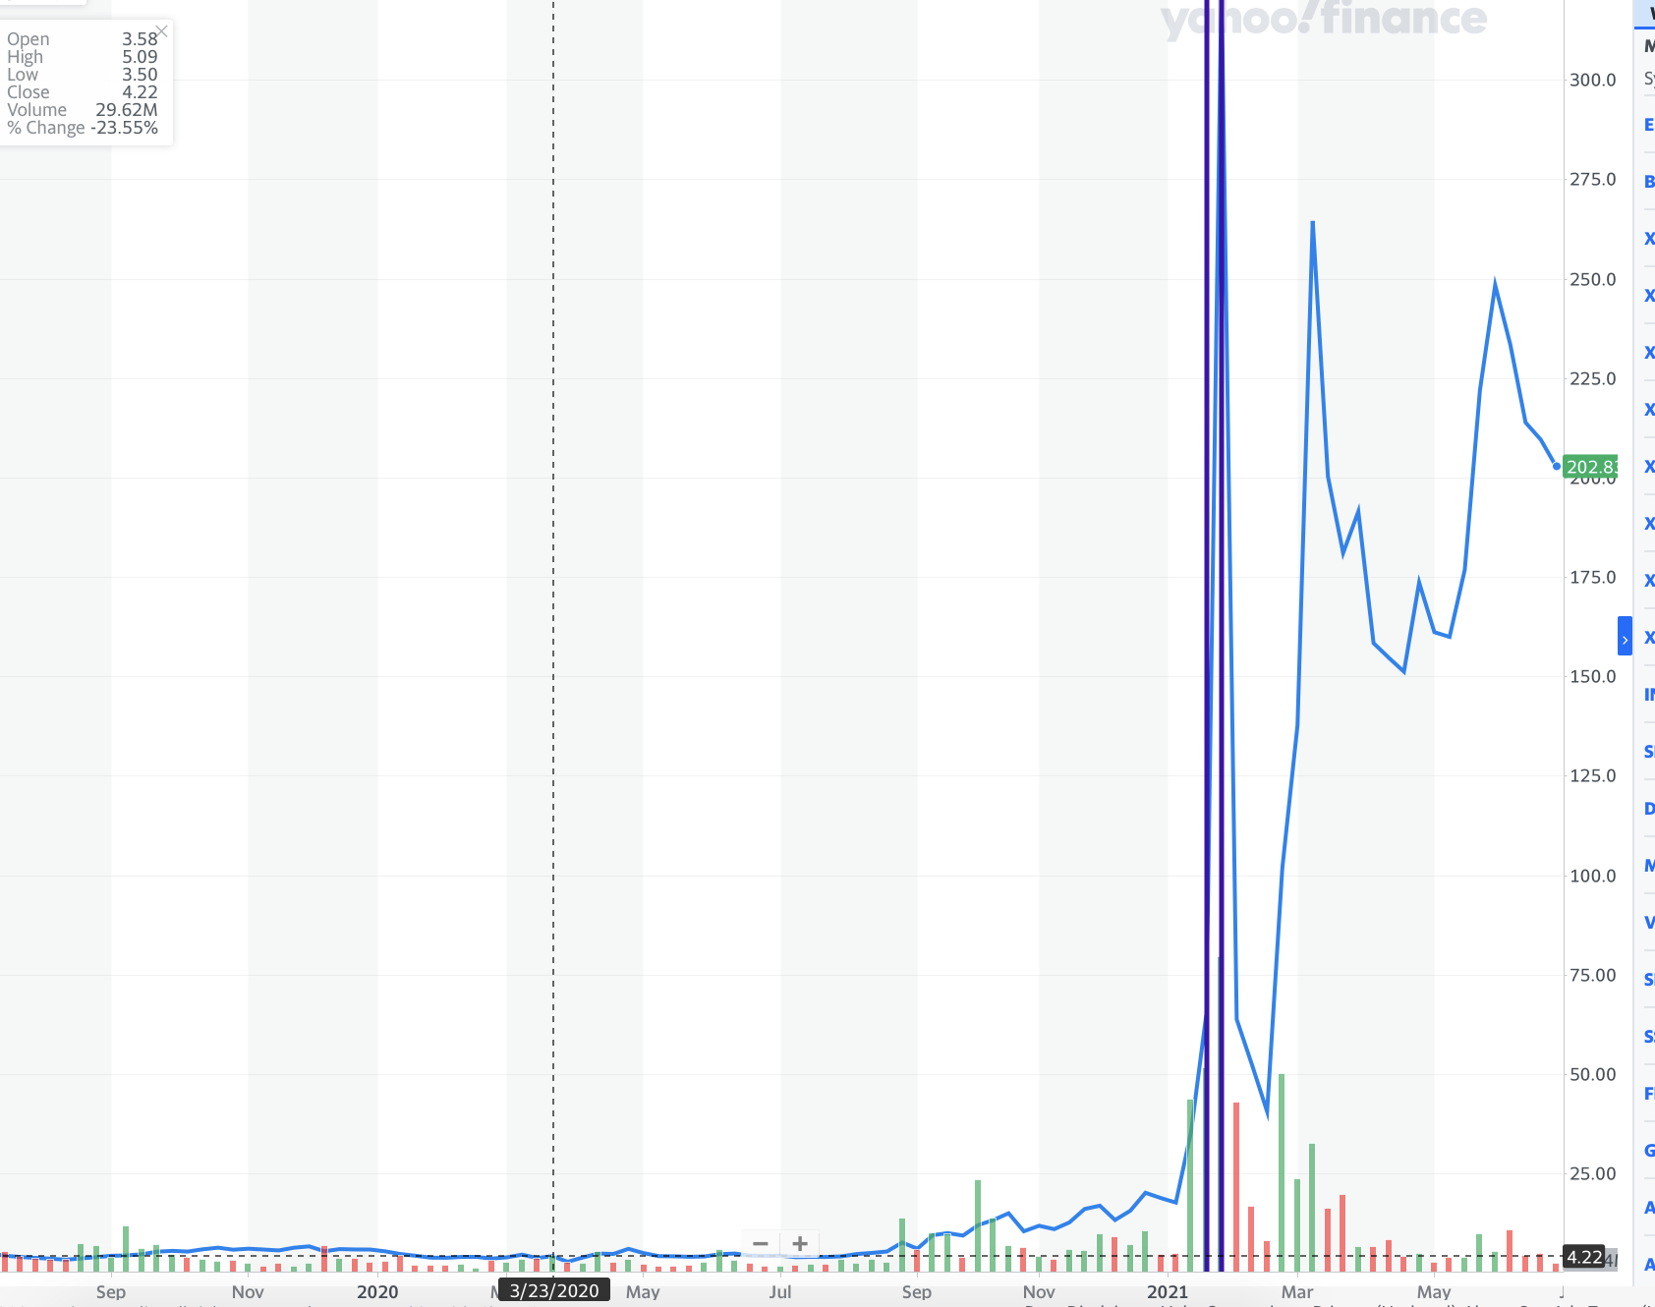
TECHNICALS
Notes:
Until 2020, price stayed low

Slide 57
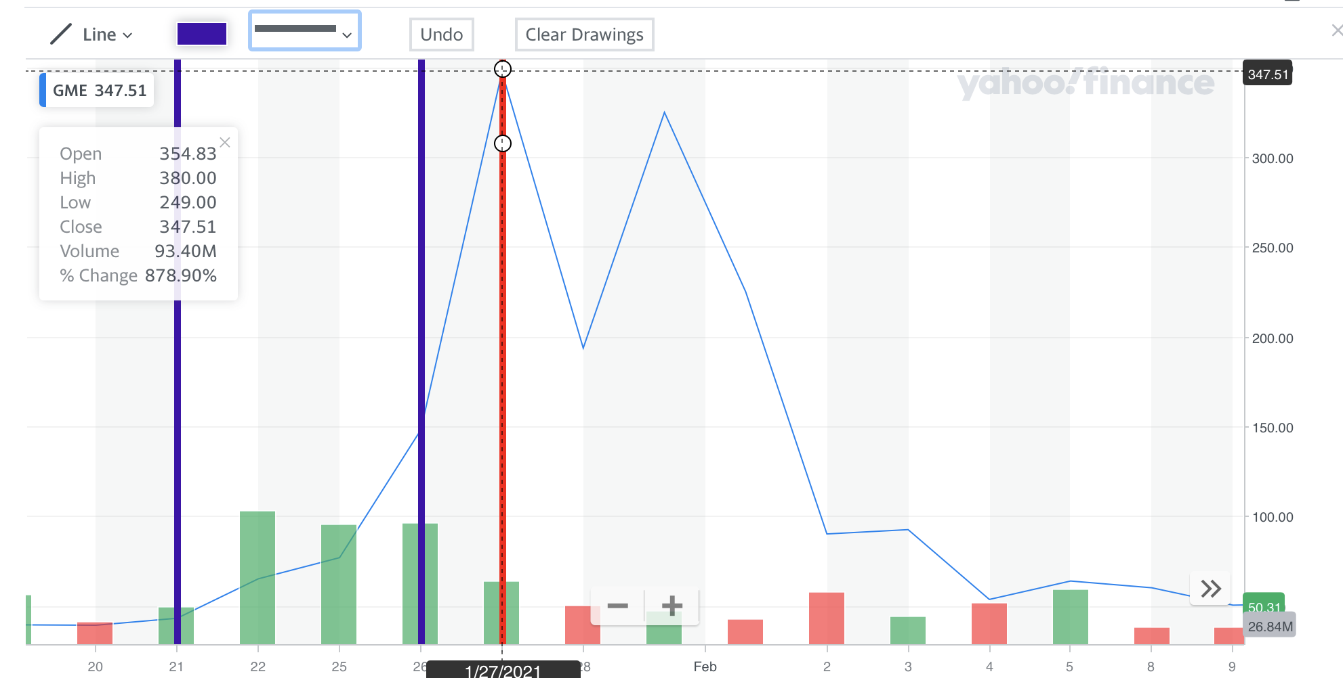
Notes:
What was the price increase from Jan 26-27; Climbed from 150 to 347; to the nearest tens, what was the increase?
350-150 =

Slide 58
Fundamental analysis

Slide 59
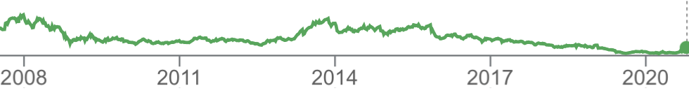
Gamestop
Biggest seller of video games
Fell in price because shift in downloads and online
  Many games like xbox can be downloaded directly
Reached a plateau in rev;
See bottom

Slide 60

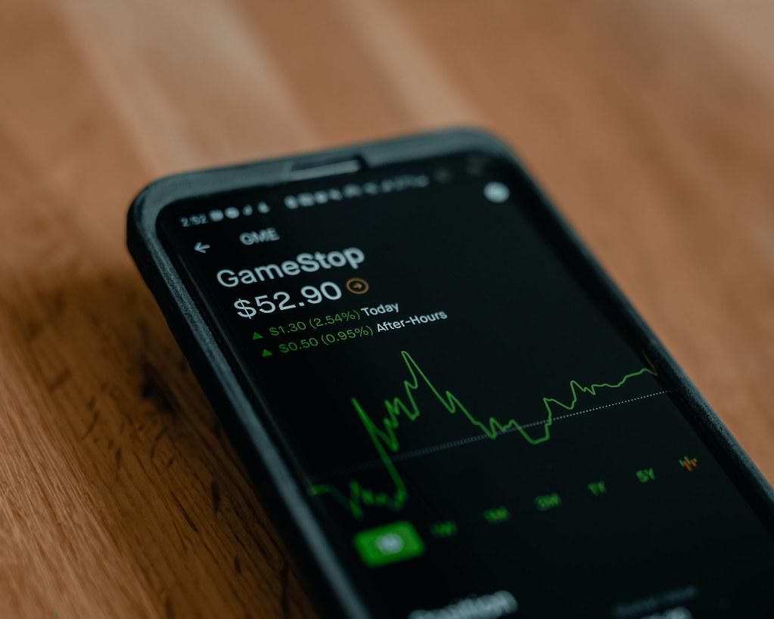
A Turnaround -What?
  a bunch of people bid up price of gamestop;
    What is it called when people inflate the price of stock?
    Hurts hedge funds betting against gamestop & also Robinhood
    Share ownerships reduced on Robinhood to stop the spike
Notes:
Market manipulation - the intentional raising or falling of price due to people buying/selling in bulk
Causes people to buy and sell panickedly

Slide 61
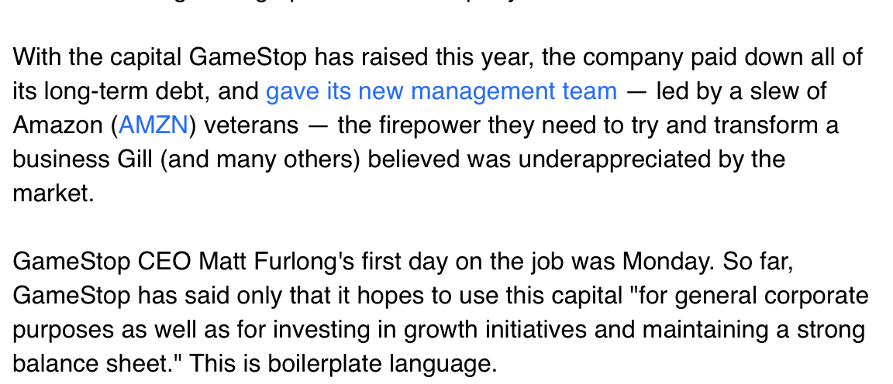
What now - Company in June 2021
Notes:
From yahoo news
And nows there a trickle effect
Company saved fr!!!
Will GameStop will grow? Can we trust the new amazon team? If same strategy, maybe bad???

Slide 62
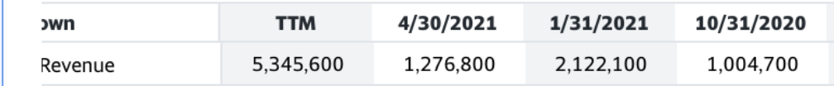
Sneak peak at revenue
How did the total change?

Slide 63
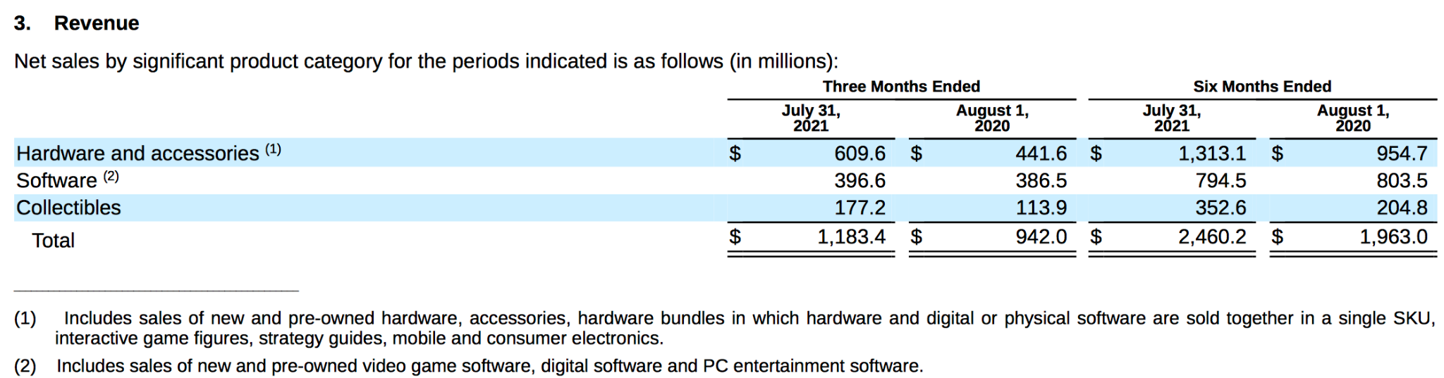
Sneak peak at revenue
How did the total change?

Slide 64
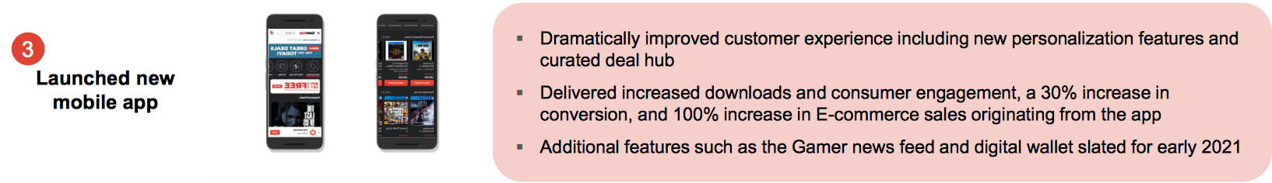
Gamestop
Business model: sale of video games / other tech products
CEO: Matt Furlong (Jun 21, 2021–) (from Amazon)
Strateg(ies) (2020)

Slide 65

Can we trust GME? What do you think?
Pros
Paid long-term debt
New leadership (CEO)
Cons
questionable business model
  most games can be downloaded NOT in-person

Slide 66
Discussion Question (choose 1 or 2)
> you are a stock market regulator: what’s one step to prevent market manipulation?
> how can investing be used as a tool for societal change?
> How this company is different from Tesla/Apple?
> Do you think more ppl suffered? Or gained?
Notes:
Is Gamestop over/undervalued?
Answers in the chat

Slide 67
Takeaways
-> it was so short…(lasted ~2 days)
really easy to have lost money then have gained:
-> market is not robotic
ppl ALSO invest in what they care for (games); not just money (unlike Apple/Tesla
Notes:
And unlike with APPl
-> observ:
the market is truly powerful (who knows how many people traded in it?)

Slide 68
Activity: Is this a good investment?
Instructions below:
https://docs.google.com/document/d/1HLzuFFZsiNpQs4b-MvOQgWwp0ey-v725ddKWjUt0qco/edit?usp=sharing

Slide 69
Research analysis
Technical
Go to Yahoo Finance - > equity screener -> let price < 300 and sector = tech
Choose the SECOND company on the list
  Is it up or down today?
  By how much (find %)
Look carefully at the 1w and 1month trend
  Does it have a upward momentum? Downward? Flat? Fluctuating?
  Is this a stock good investment for profit?
    If so, is it long/short term?

Slide 70
Research Analysis - Moderna
Fundamental - qualitative
Go to https://investors.modernatx.com -> Corporate Presentation
For each question, feel free to write it down, take a screenshot (if possible)
Who is the CEO?
What is the Business Model (include List three drugs produced)
What is ONE strategy they have (there are many - indicate where you found)
Does this company based on your analysis a good investment?
Moderna Specific Question
Bonus: list three countries the vaccine is produced

Slide 71
Moderna
Fundamental - quantitative
Go to https://investors.modernatx.com -> Corporate Presentation
For each question, feel free to write it down, take a screenshot (if possible)
By how much did Revenue change from Q1 to Q2 2020 (percentage Change)
How about Cash?
Is the company financial stable/close to bankruptcy
Bonus: list three countries the vaccine is produced

Slide 72
When done, choose another company and repeat
I.e zoom, amazon, snapchat….

Slide 73
Many ways to choose
All low price companies (or high priced)
Companies with high profits
Companies that have certain value (medical, technological)
……
Companies can be found through an equity screener

Slide 74
Takeaway
-> Ways to analyze
Technical Investing
Fundamental Investing
-> How to screen?
- ESG companies; yahoo finance equity screener (one of many)

Slide 75
STOP (additional material here)

Slide 76
Investing Philosophy -> yahoo finance

Slide 77
ESG/Moral Companies companies
what about sustainable/ethical companies?
Environment - companies that are mindful of act against operations that hurt our environment
i.e. Bloom energy (uses hydrogen gas instead of carbon), any renewable;
Social - companies that have maintain positive social environment for its workers
i.e. (good pay, diversity) tech comp
Governance - companies where board of directors has positive interests, ceo has fair pay
i.e.
Notes:
important to know as your fa might apply this
if you’re concerned look at ESG stocks -
acronym
ESG stocks are known for being sustainable and good corporate practices
to go deeper, her’s what each things means:
example f4 social - axon, microsoft, tech in general
theses are just companies that can used as an example
4govt - are the leaders looking out for themselves or company
There mtfs that screen so no need to do the reseach
what are companies you consider to be ESG and undervalued/overvalued; we can talk about it??

Slide 78
Moral Investing
i.e. Stocks that align with values of particular religion - SIMILAR TO ESG
A portfolio, i.e., might avoid companies w/ antithetical values (“tobacco, gambling…”)
*Returns from moral/ESG aren’t much different from other
Notes:
https://www.investopedia.com/articles/stocks/12/investing-and-faith.asp#does-faith-based-investing-work’
There mtfs that screen so no need to do the reseach
idea is to show you how varied companies can be, and how you can choose the stock that you desire

Slide 79
Social Justice/Responsibility Investing
> Three ways to impact companies
Divest
Invest in better companies
Protest (use shares to vote)

Slide 80
What else can you do with your shares: vote
You can use your shares to vote:
Influence company decisions/CEO
Change up the board of directors
Notes:
Each share gives you one vote
If someone owns more than 50% of company-- they can basically control the firm (i.e FB)

Slide 81
Case: Rio Tinto
> works in location in Spain
> 2nd largest manufacturer of metals: gold, uranium, steels, etc.
-> mining company
-> controversies: human labor & carbon emissions
-> divest? Or what? Invest in ESG? Voting right

Slide 82
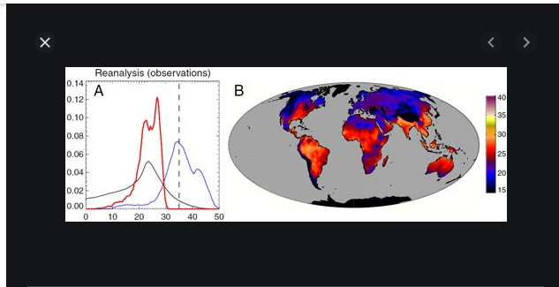
Why divest?
Some companies emit too much carbon
Could be approaching a danger zone in terms of global warming
Notes:
35 degrees is lethal ; this measures wet bulb temperatures (takes into account humidity, not just raw temperature) We see that parts of southern hemisphere are at risk…..this is one argument to make for divestment from fossil fuels
Enphase, renewable energy group, solar edge -> avoid investing TOO much into companies (rio tinto, Exxon,

Slide 83
Takeaway
Materials
> Three ways to impact companies
Divest
Invest in better companies (i.e ESG)
Protest (use shares to vote)

Slide 84
BACKUP MATERIAL
BACKUP MATERIAL

Slide 85

Apple

Slide 86
Technical analysis

Slide 87
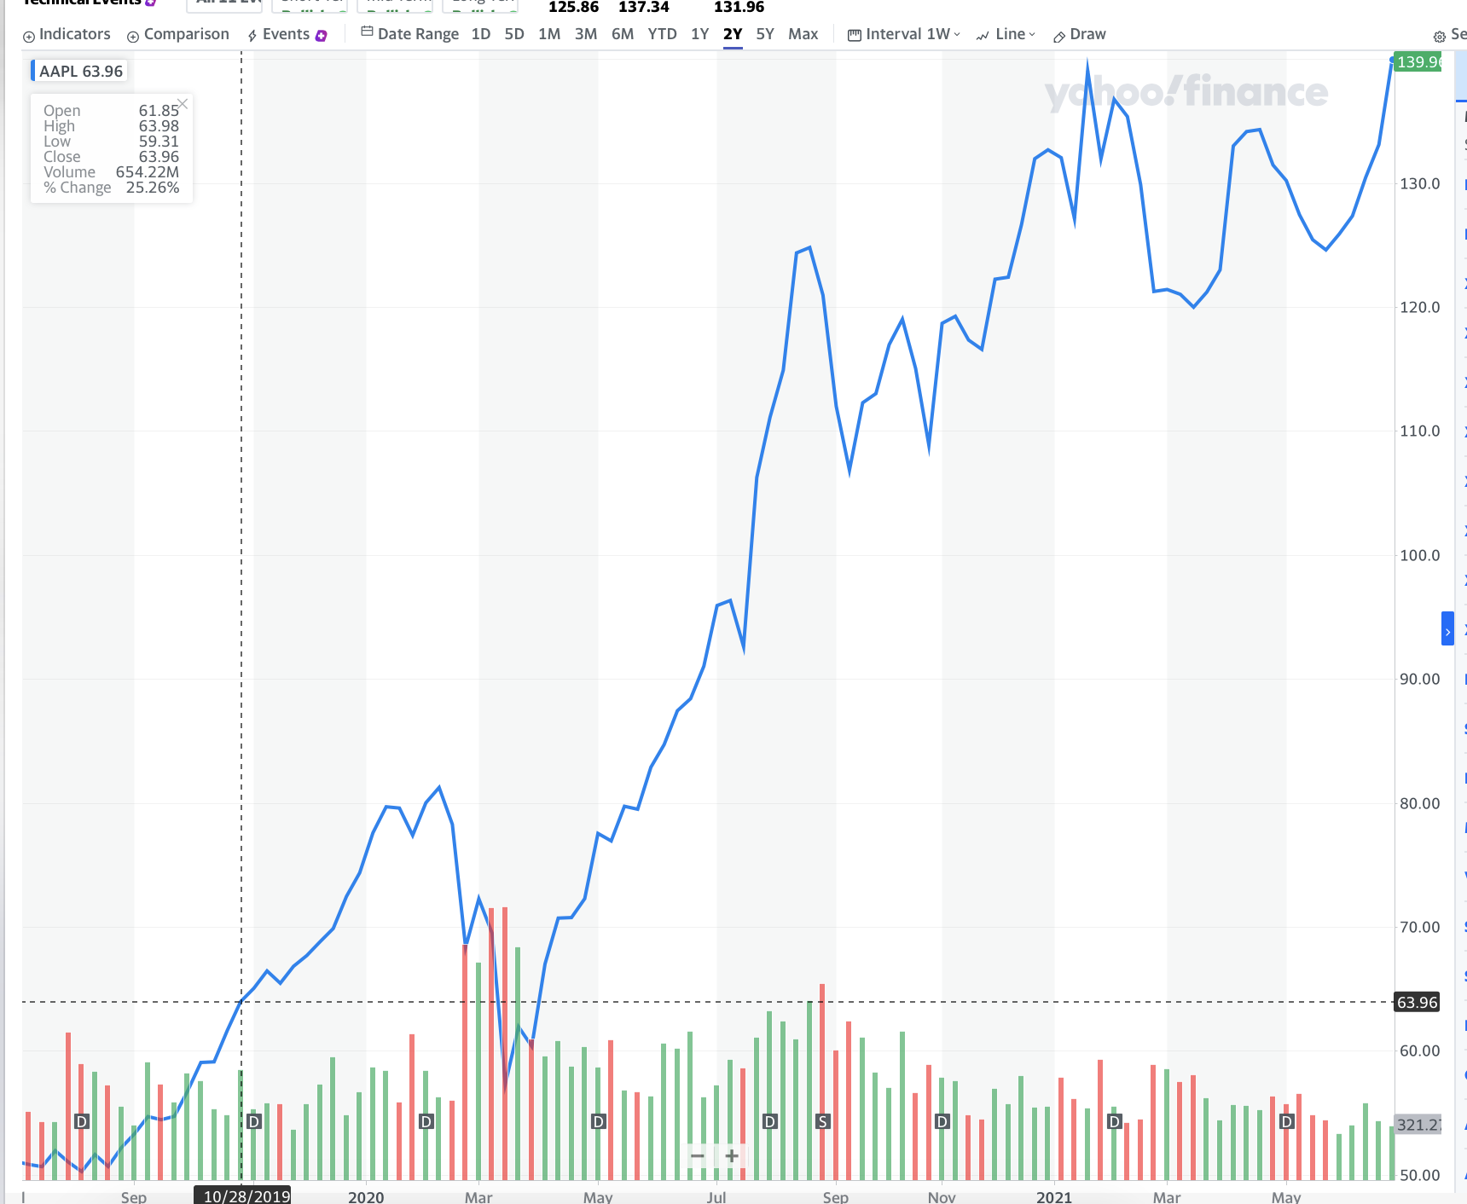
Technical Investing
Notes:
Technically speaking, linear increase for year, only now looks like its been stagnate; Not hard to see an increasing trend
Apple mirrors the economy pretty well (if economy up then apple and vice)
Growth is slow
Not volatile
Is OK, but best
Short term vs long term Vs midterm
Short- term stagnate
Mid-term stagnate
Better for long term; not short/middle
Looks like it will grow
Look at the patterns
Small chance it wont (overvalued)?
Where do you think price will go?
Profit if invested 2020

Slide 88
Fundamental analysis

Slide 89


Business Model/CEO
Sells computer equipment and software
High quality brands - Ipads, iphones, watches, macs?
most valuable - first company to reach 1 trillion dollars in MC (the Harvard of companies)
CEO: Tim Cook
Notes:
Include talk about latest brands
Who doesn't own apple
-- like tesla, has its controversies

Slide 90
Apple
most valuable - first company to reach 1 trillion dollars in MC (the Harvard of companies)
Notes:
Include talk about latest brands
Who doesn't own apple
-- like tesla, has its controversies

Slide 91
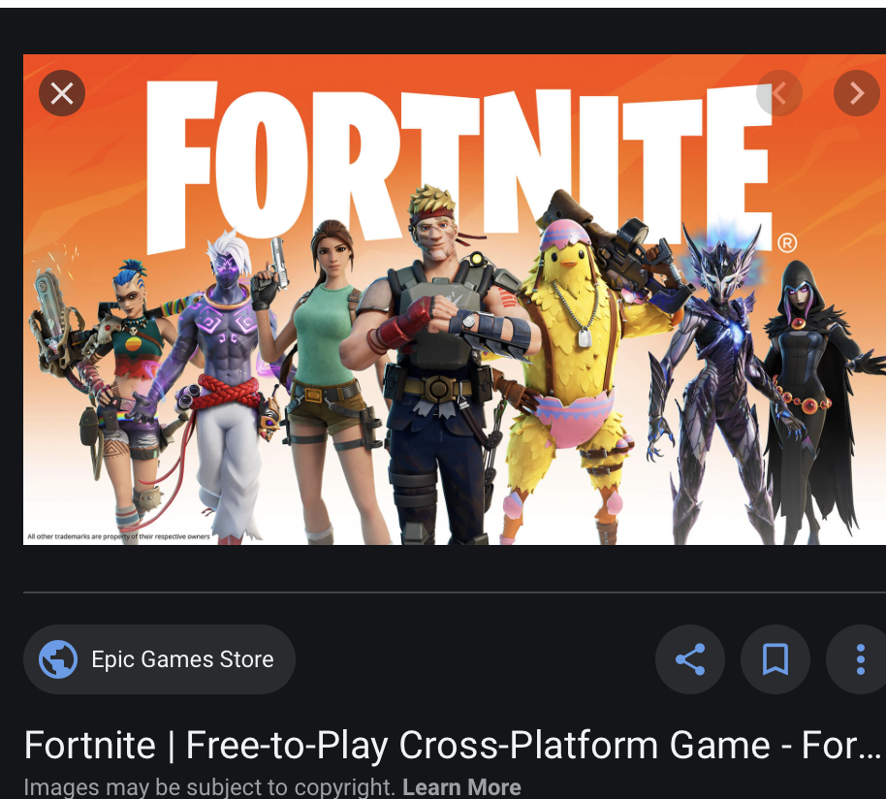
Controversies (notable) - time permitting
Apple Store Fee Collection
Notes:
3rd person shooter game, play up to 99 other people
Lashback from EPIC games,
More than 2bn taken from epic games possibly? Is this ok?
Collected high fees - true possible for other apps

Slide 92
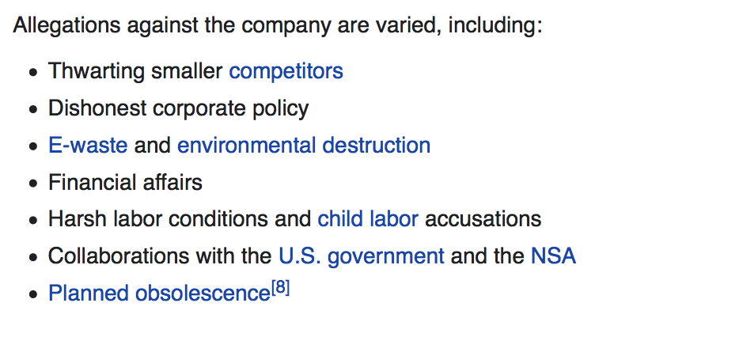
Cont
All available on WIKI
Notes:
Other accusations include:
Easily
Is it a monopoly? Should apple be dealt with? What will the outcome be?

Slide 93
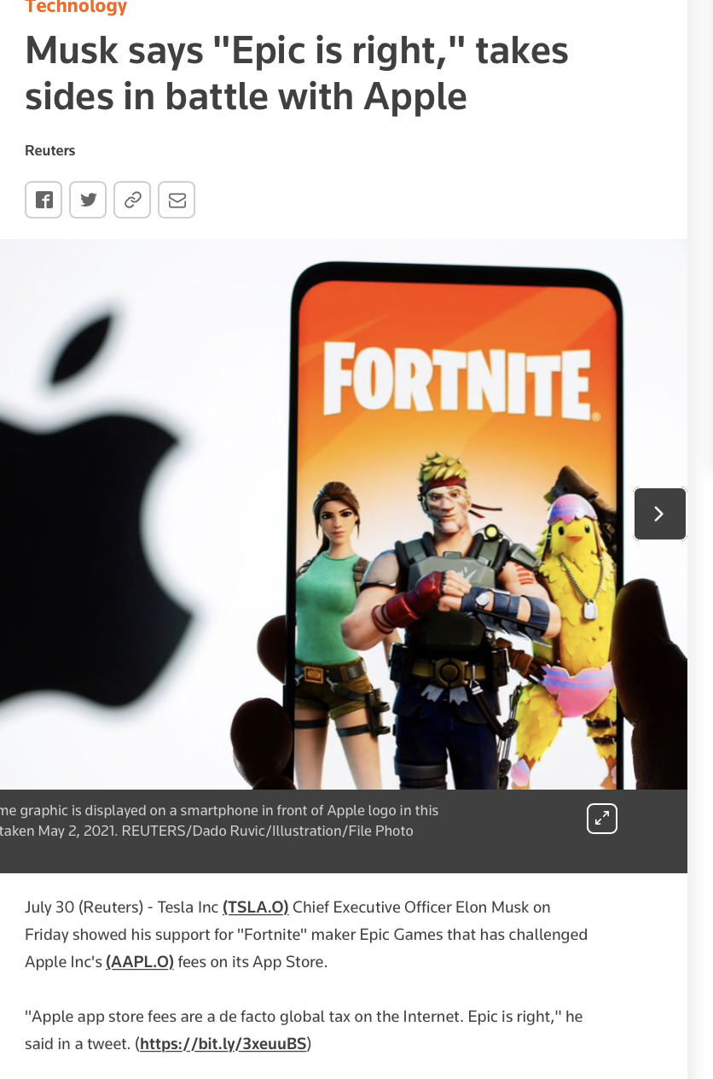
Notes:
Global tax on internet

Slide 94
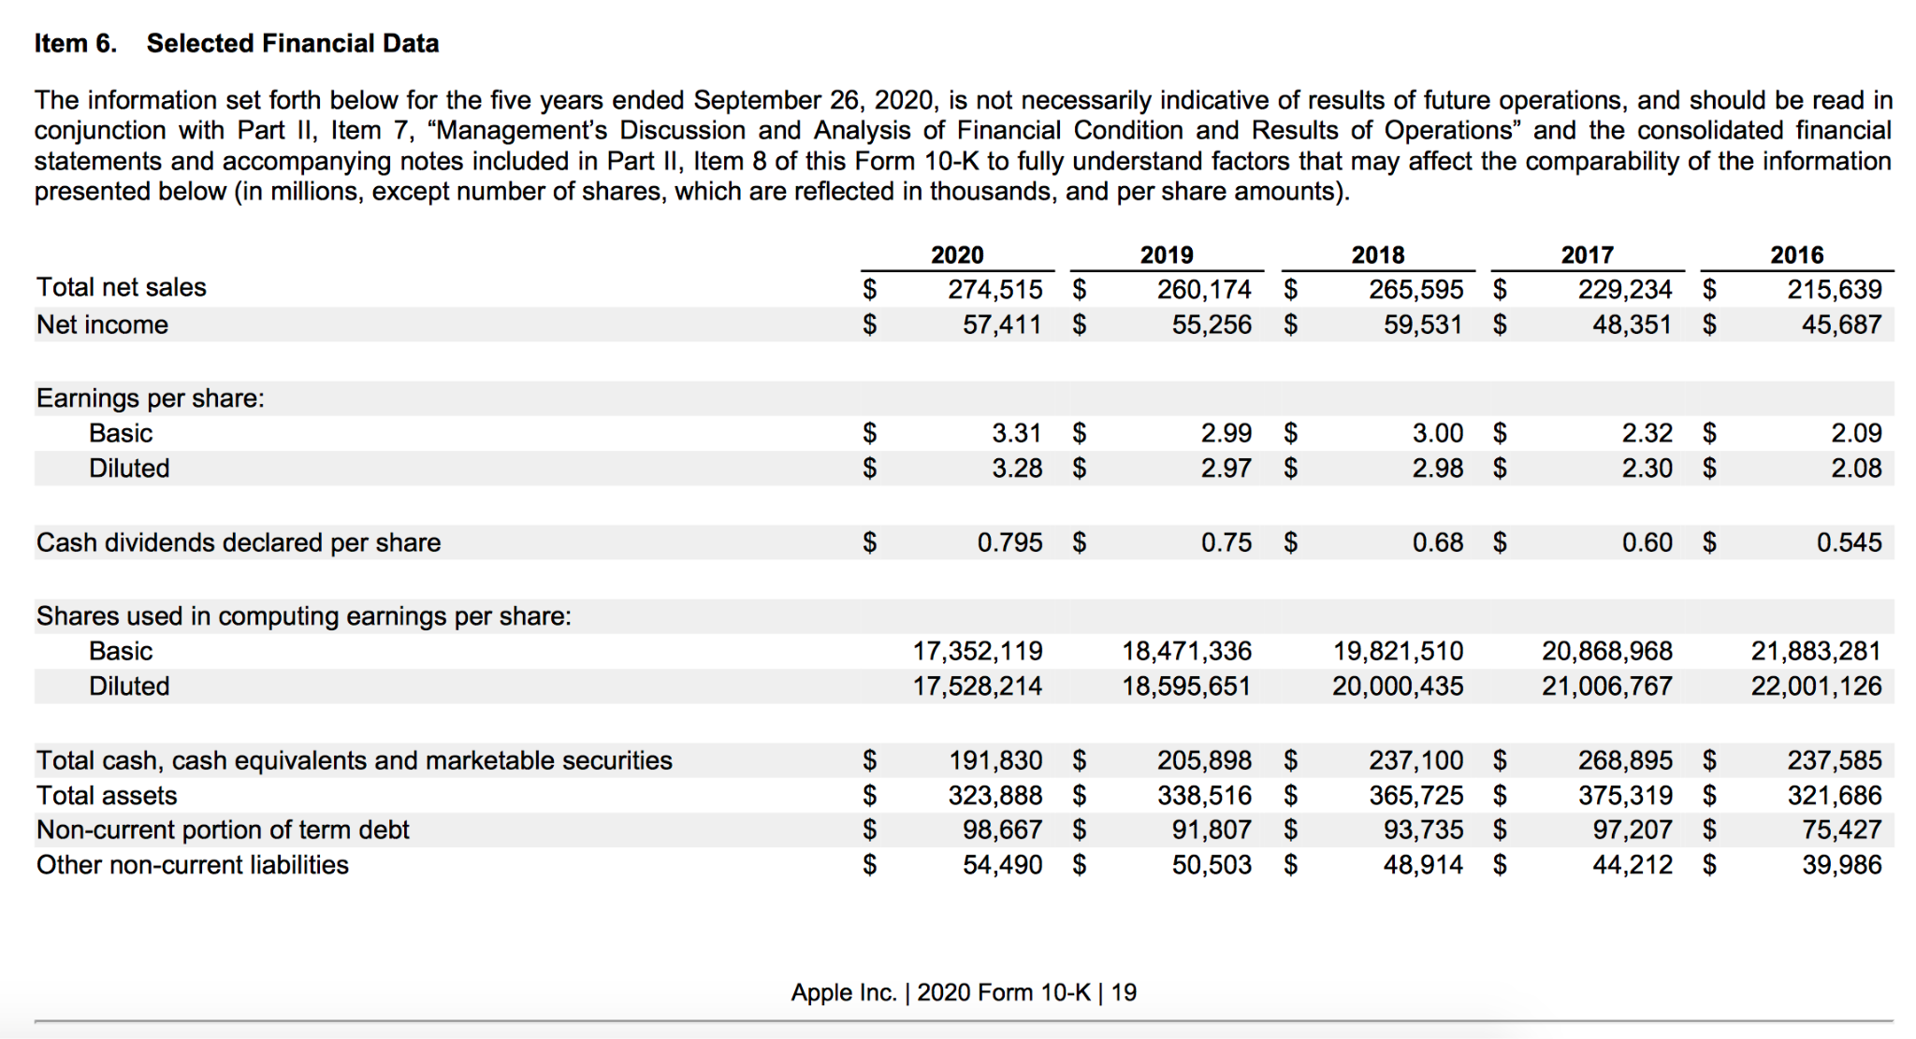
Quantitative
Notes:
Each category has linear / stable trend
What are the trends you guys see in this chart?
No red flags

Slide 95
Takeaways
Apple
Strong technicals
Strong NI
Monopoly?
Should one invest? You decide

Slide 96
Is apple a good company (compared to Tesla)?
Consider:
Sector?
Price trends
Revenue
Type of products/value to society
controversies/major fallours

